Slide 1


Ansible Inventory

Slide 2


WHAT IS ANSIBLE INVENTORY ?
Ansible inventory is a mechanism in Ansible that lists and organizes hosts (servers, machines, or other network devices) that Ansible manages. The inventory provides Ansible with a list of hosts on which it can operate using playbooks, ad-hoc commands, or other automation tasks

Slide 3
Key points about Ansible inventory
Static vs. Dynamic Inventory:
Static Inventory: This is the traditional method, where you manually list your hosts in an INI or YAML format. This works well for a stable set of hosts.
Dynamic Inventory: In cloud environments or other rapidly changing infrastructures, the set of hosts might change frequently. Ansible provides a way to generate an inventory dynamically from external sources like AWS, Azure, Google Cloud, etc.
Hosts and Groups:
Hosts: These are the machines on which you'll run commands. They can be specified using IP addresses or DNS names.
Groups: To make management easier, hosts can be grouped. For instance, all web servers can be in one group, and all database servers in another. This allows for targeting specific kinds of machines with specific tasks.
Group Variables and Host Variables:
These allow you to define specific variables for particular hosts or groups. For instance, all machines in the 'web' group might get a variable defining a certain package version, while a specific host might have a unique configuration.
Default Inventory File:
By default, Ansible looks for an inventory file at /etc/ansible/hosts, but you can specify a different inventory using the -i option with ansible and ansible-playbook commands or by setting it in the ansible.cfg configuration file.

Slide 4
Key points about Ansible inventory
Example of a Static Inventory:
[webservers]
web1.example.com
web2.example.com
[databases]
db1.example.com
db2.example.com
[all:vars]
ansible_user=deployer
In this example, we have two groups (webservers and databases) and a global variable (ansible_user) defined for all hosts.
Dynamic Inventory Scripts:
These are typically scripts (or sometimes configurations) that pull host information from external sources. When called with --list, the script should output a JSON representation of the inventory.
Using the right type of inventory for the right environment can make Ansible much more powerful, especially when combined with dynamically created infrastructure in cloud environments.

Slide 5

AMI

Slide 6
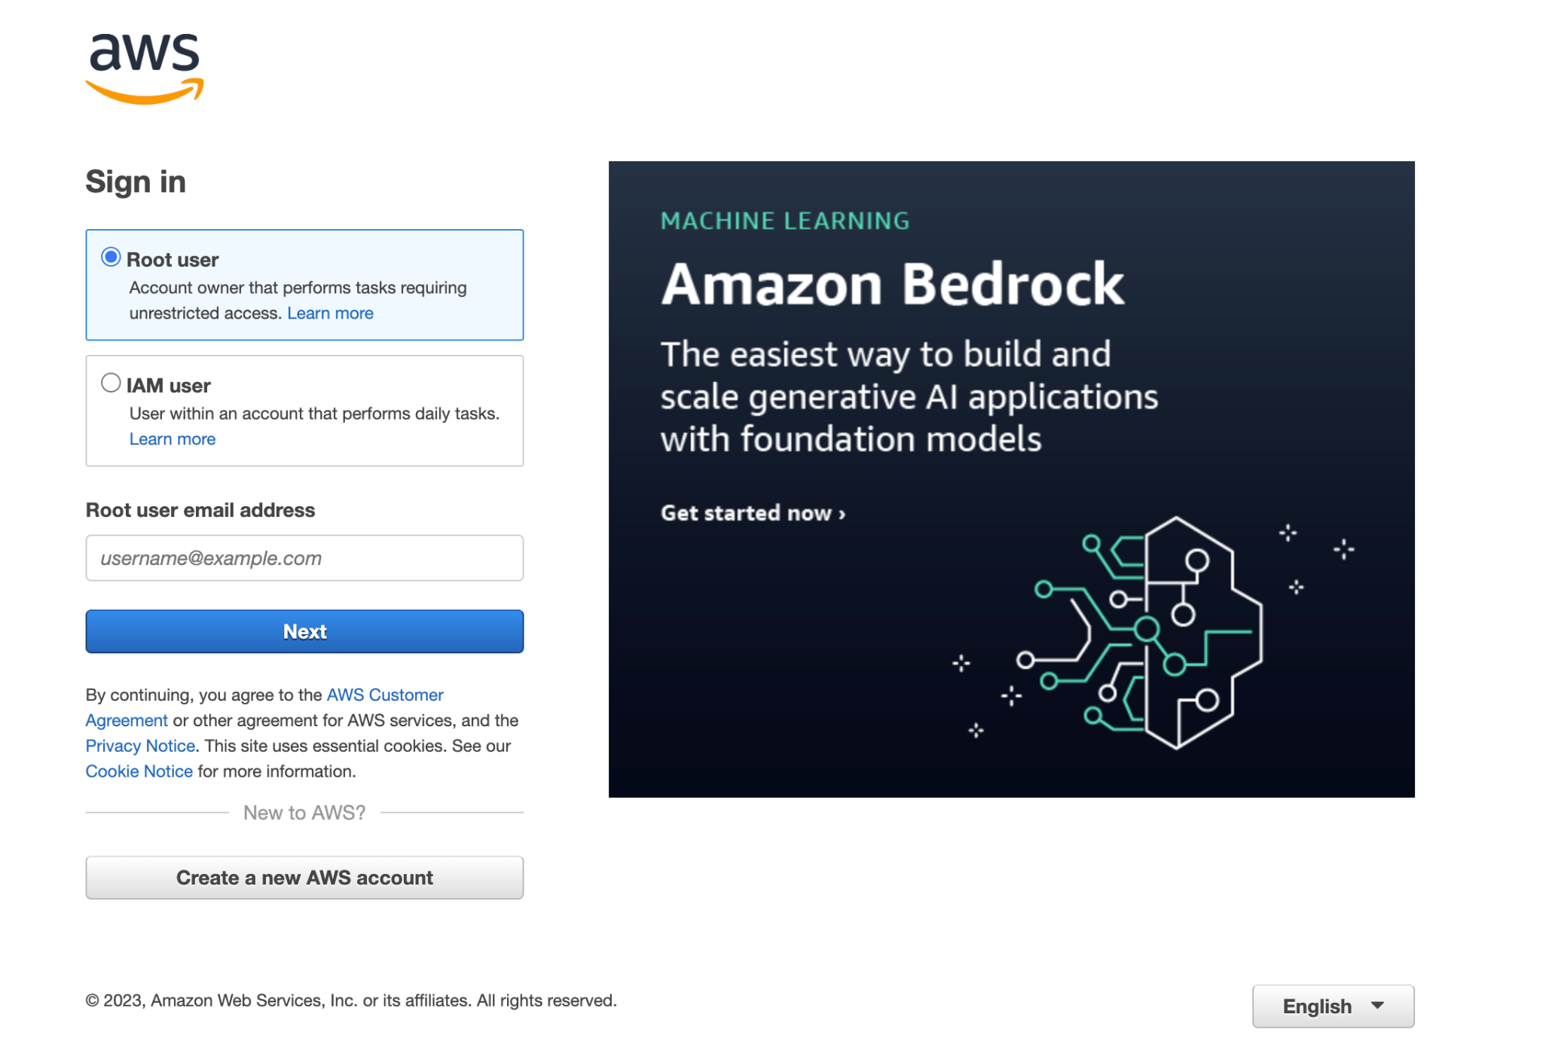
How to create a master AMI for ansible
1
Login to AWS

Slide 7
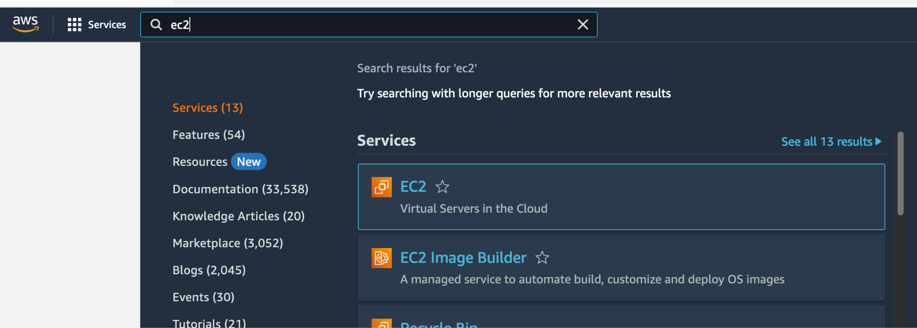
How to create a master AMI for ansible
2
3
Select EC2
Click on service
4
Enter EC2

Slide 8
How to create a master AMI for ansible
2
4
Select EC2
Click on service
3
Enter EC2

Slide 9
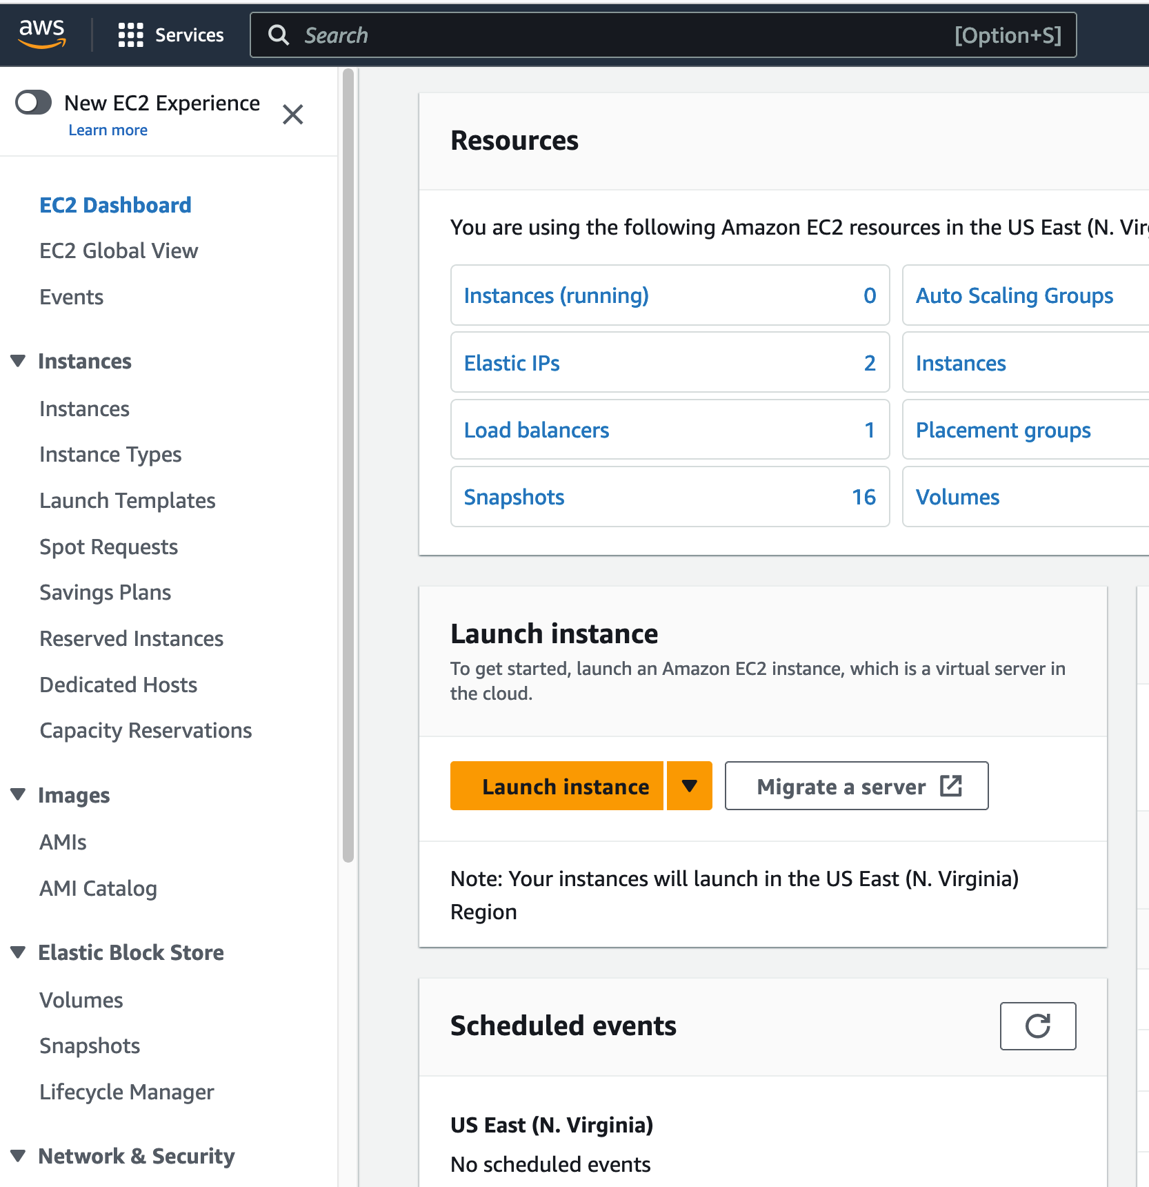
How to create a master AMI for ansible
5
Select launch instance

Slide 10
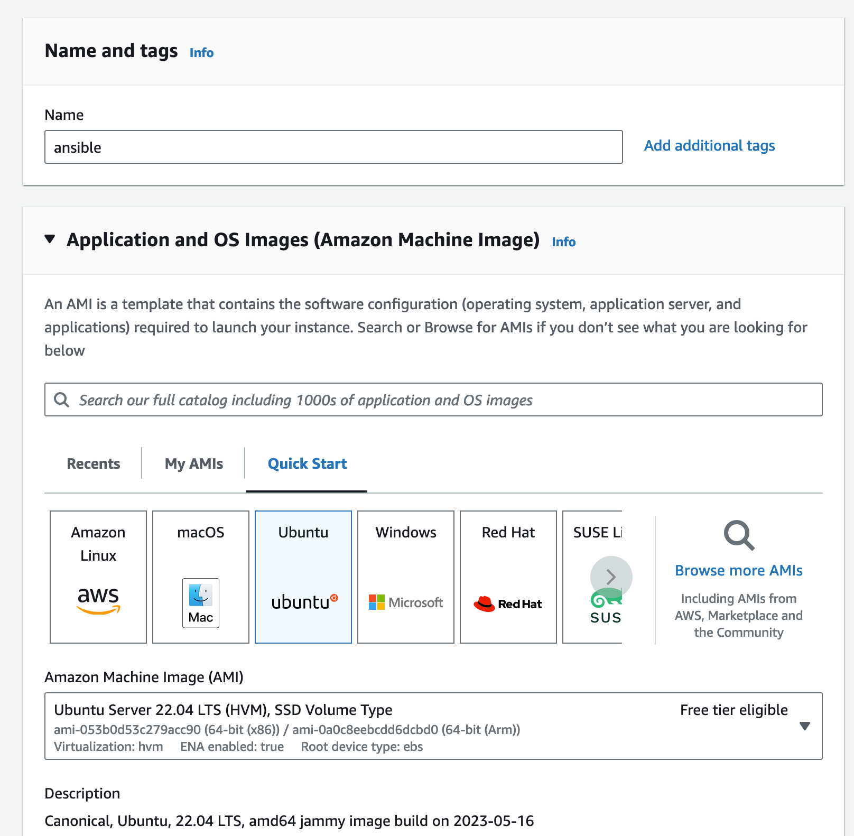
How to create a master AMI for ansible
6
Enter the instance name
7
Select the instance operating system

Slide 11
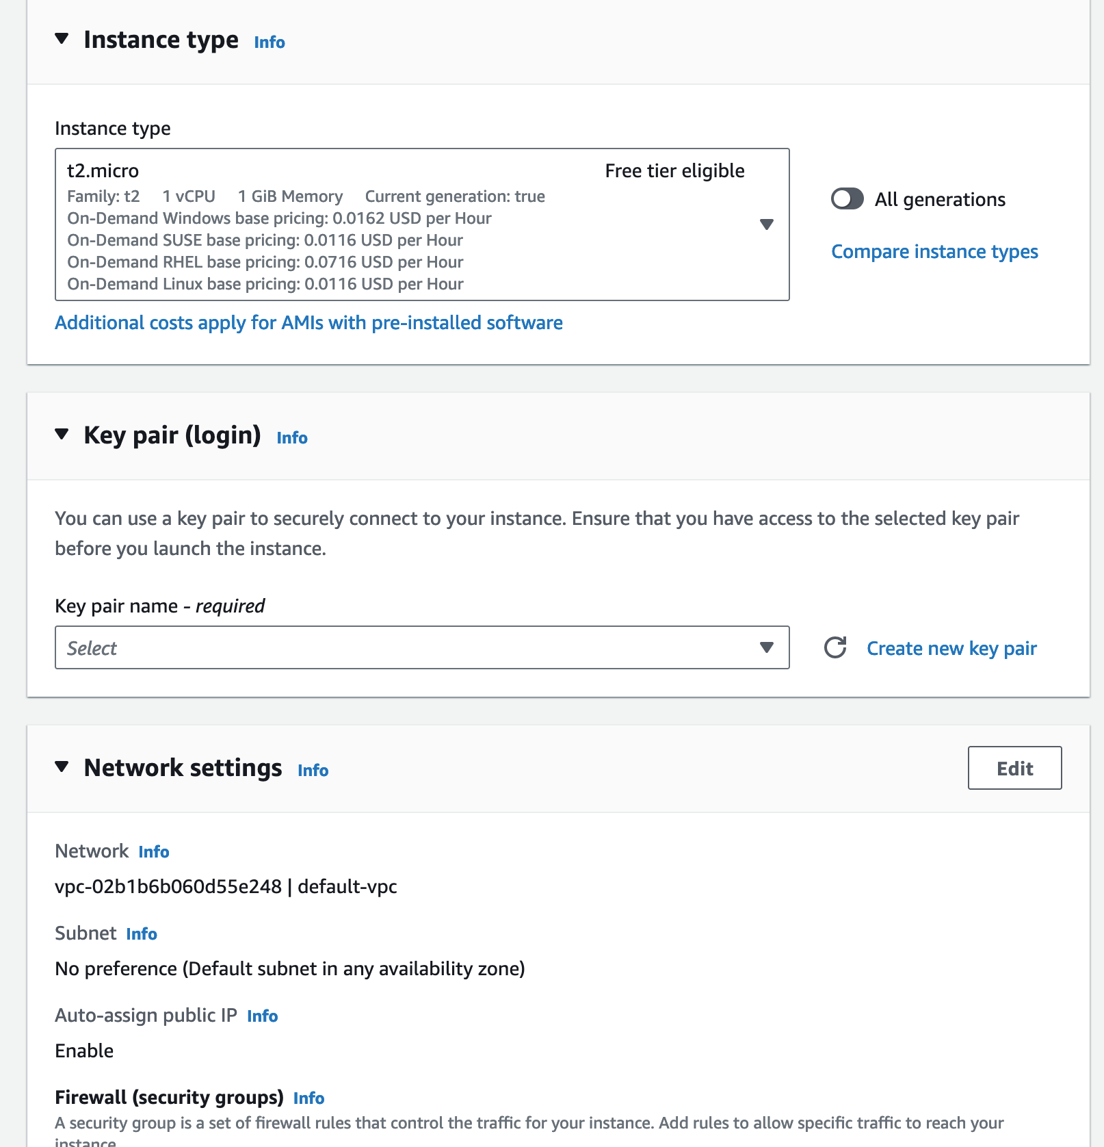
How to create a master AMI for ansible
8
Select instance type
Please keep this at t2.micro
Create a new keypair
9

Slide 12
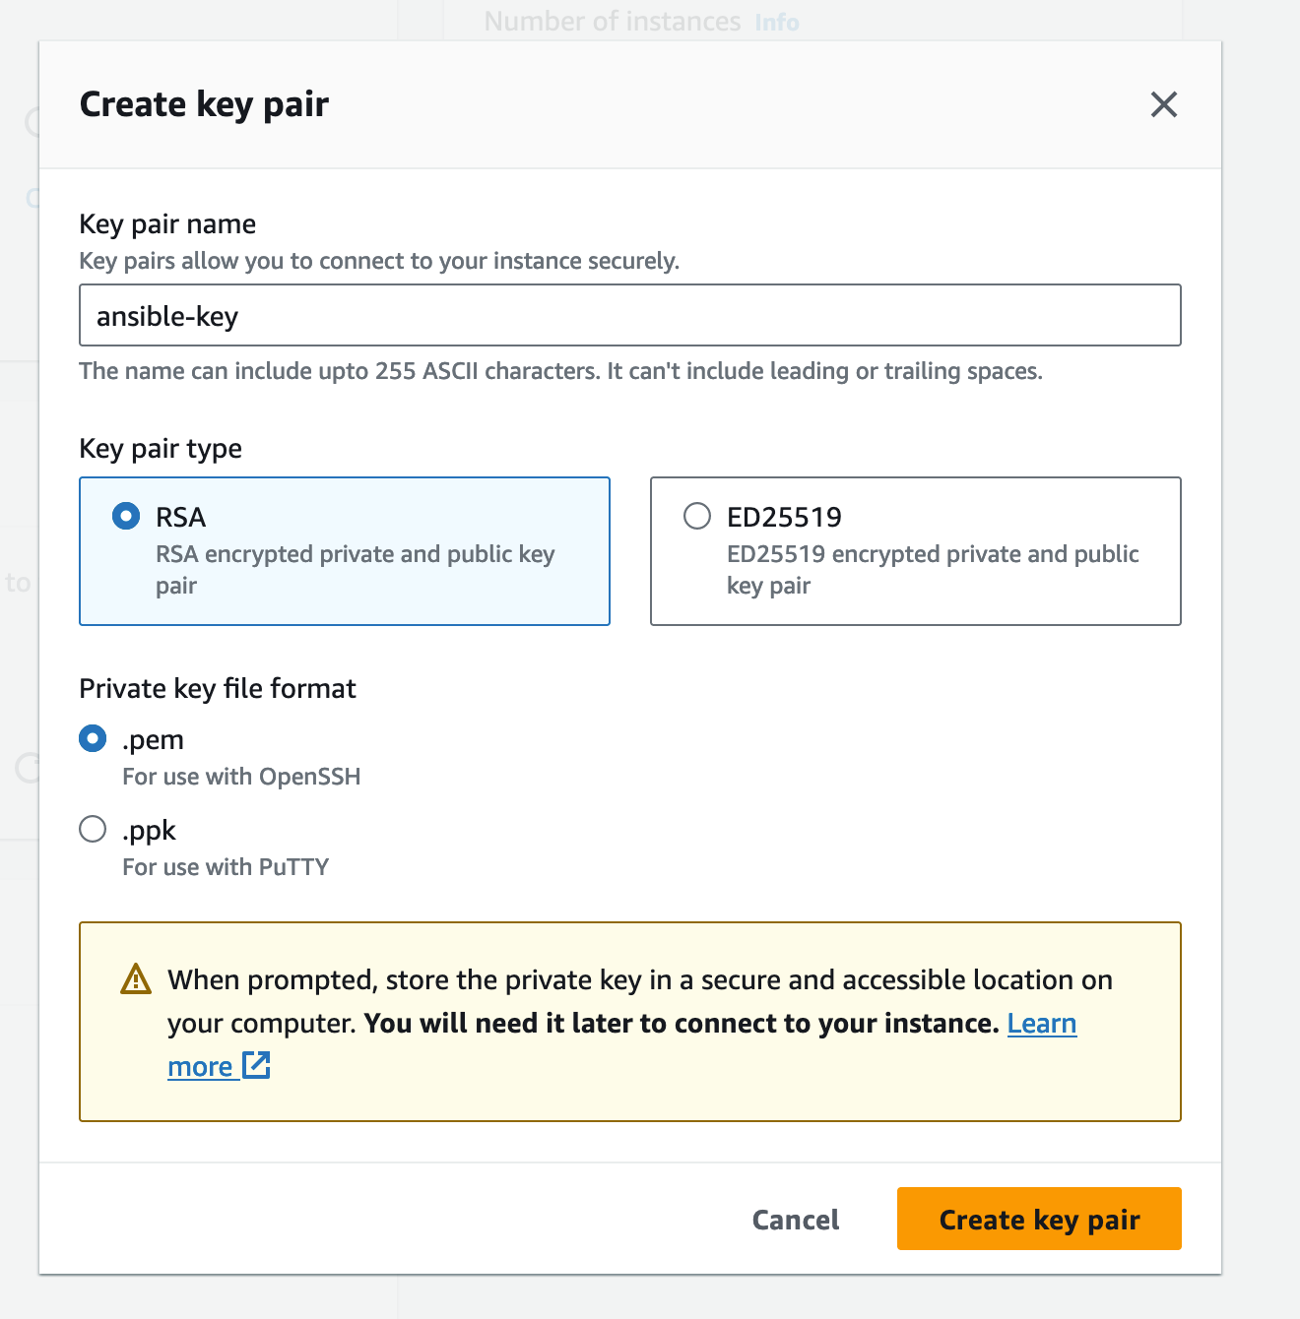
How to create a master AMI for ansible
The key will be downloaded to your Downloads folder once created
10
Enter the key name
11
Create the
keypair
Click here
13
12
Click here

Slide 13
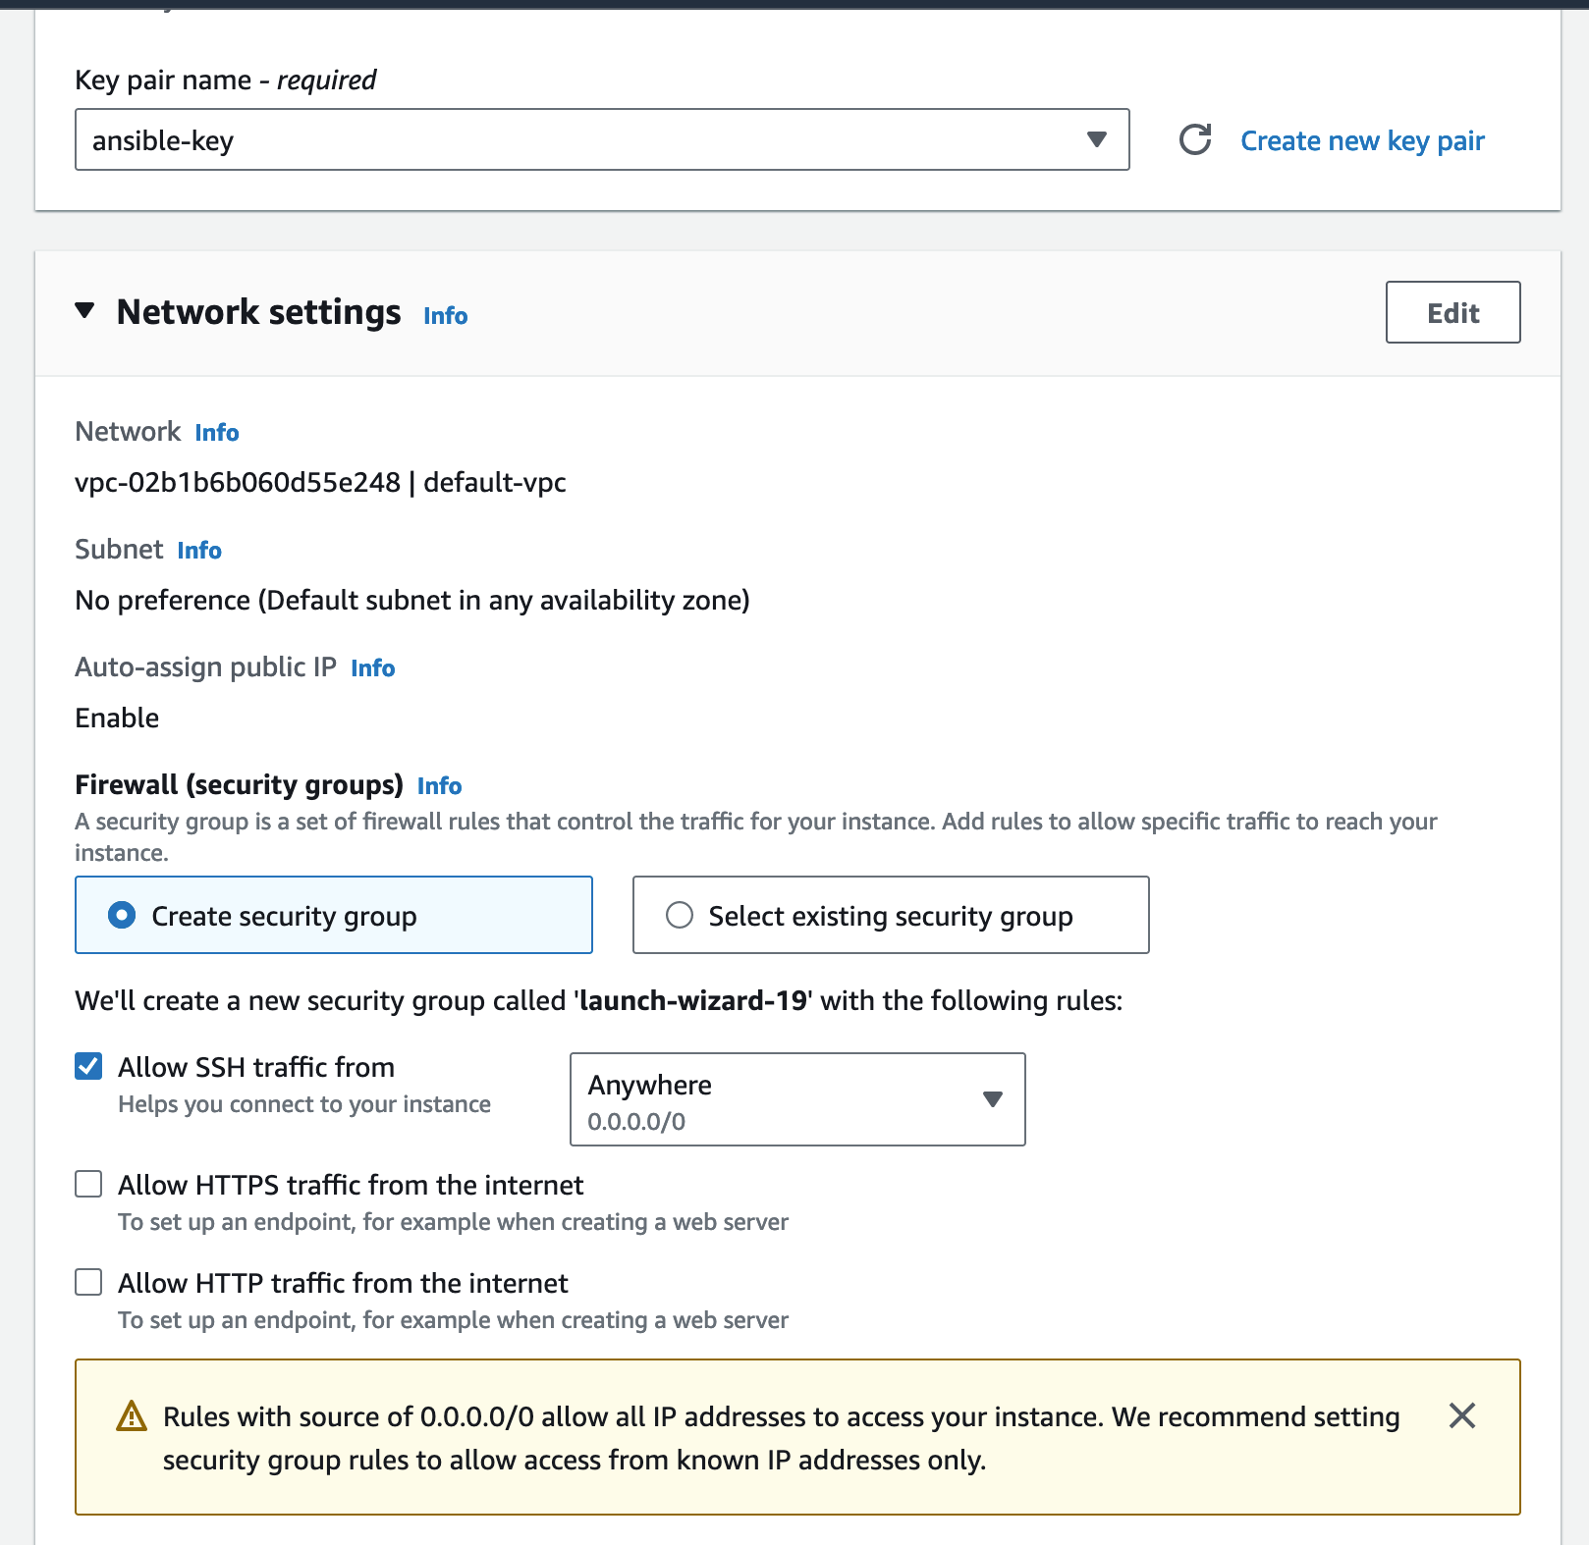
How to create a master AMI for ansible
14
Select the key
15
Click here
16
Check here

Slide 14
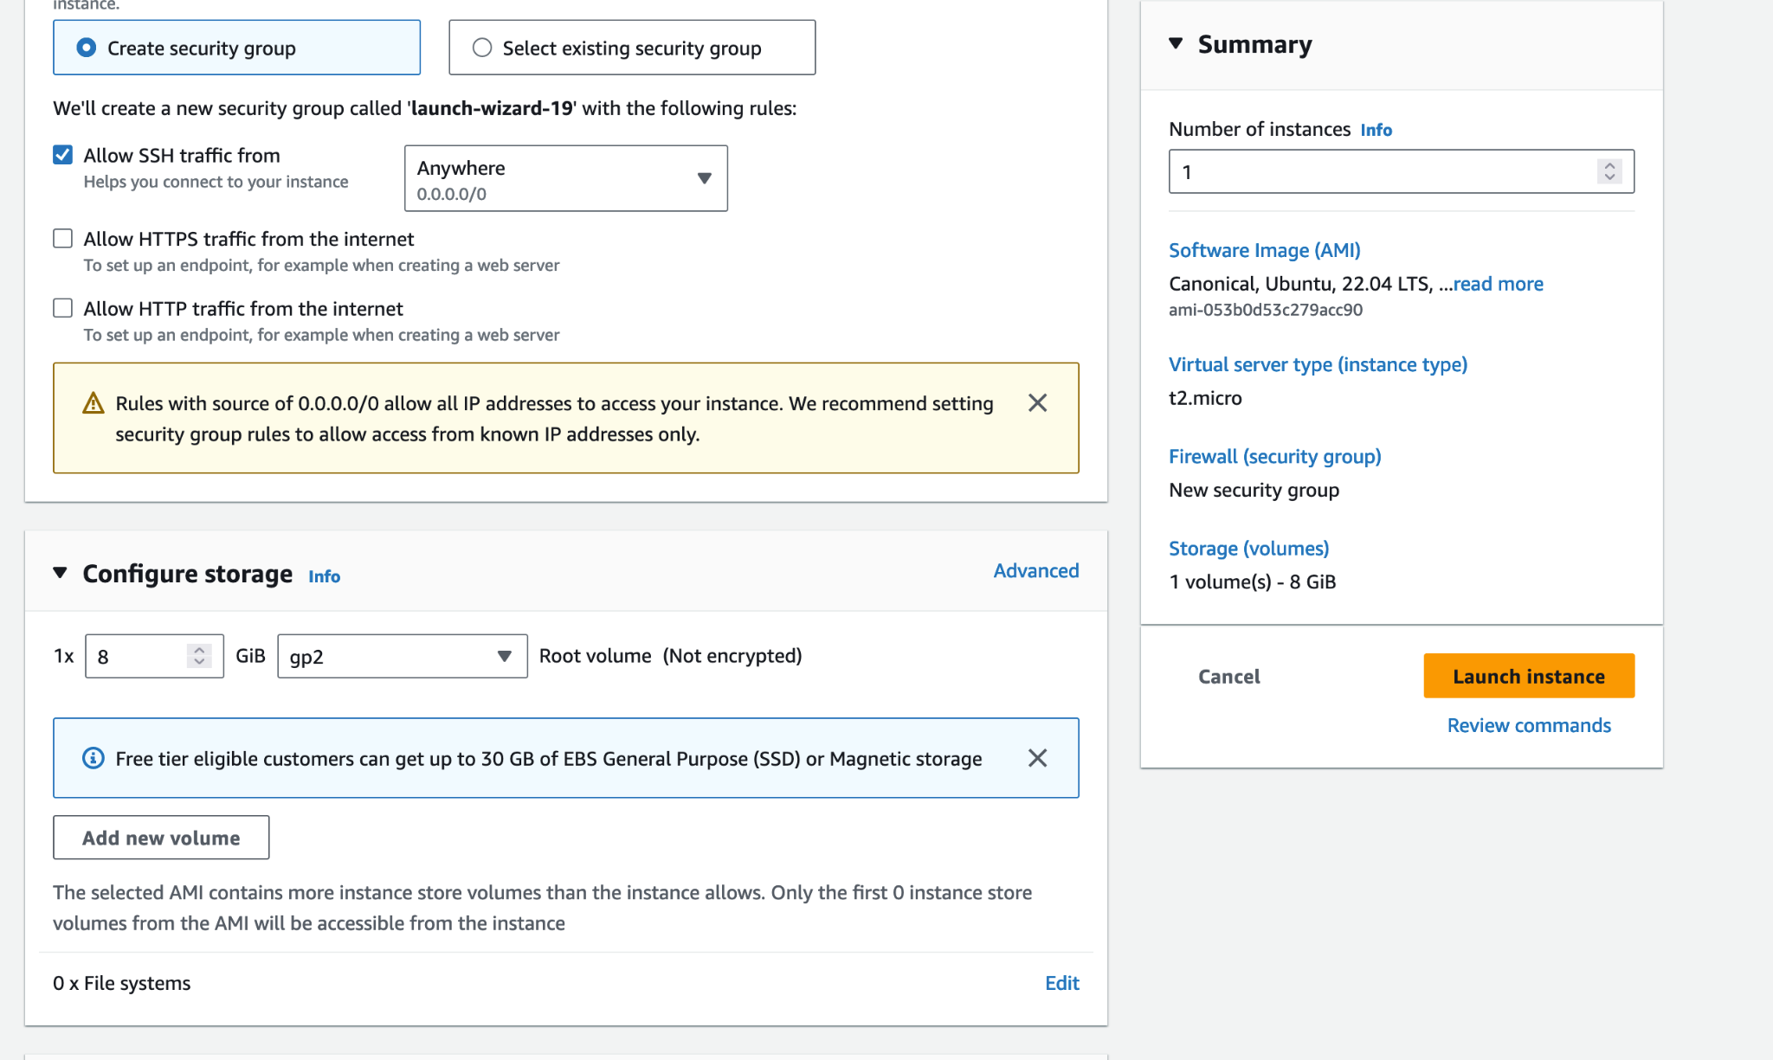
How to create a master AMI for ansible
Select the key
17
Launch the instance

Slide 15
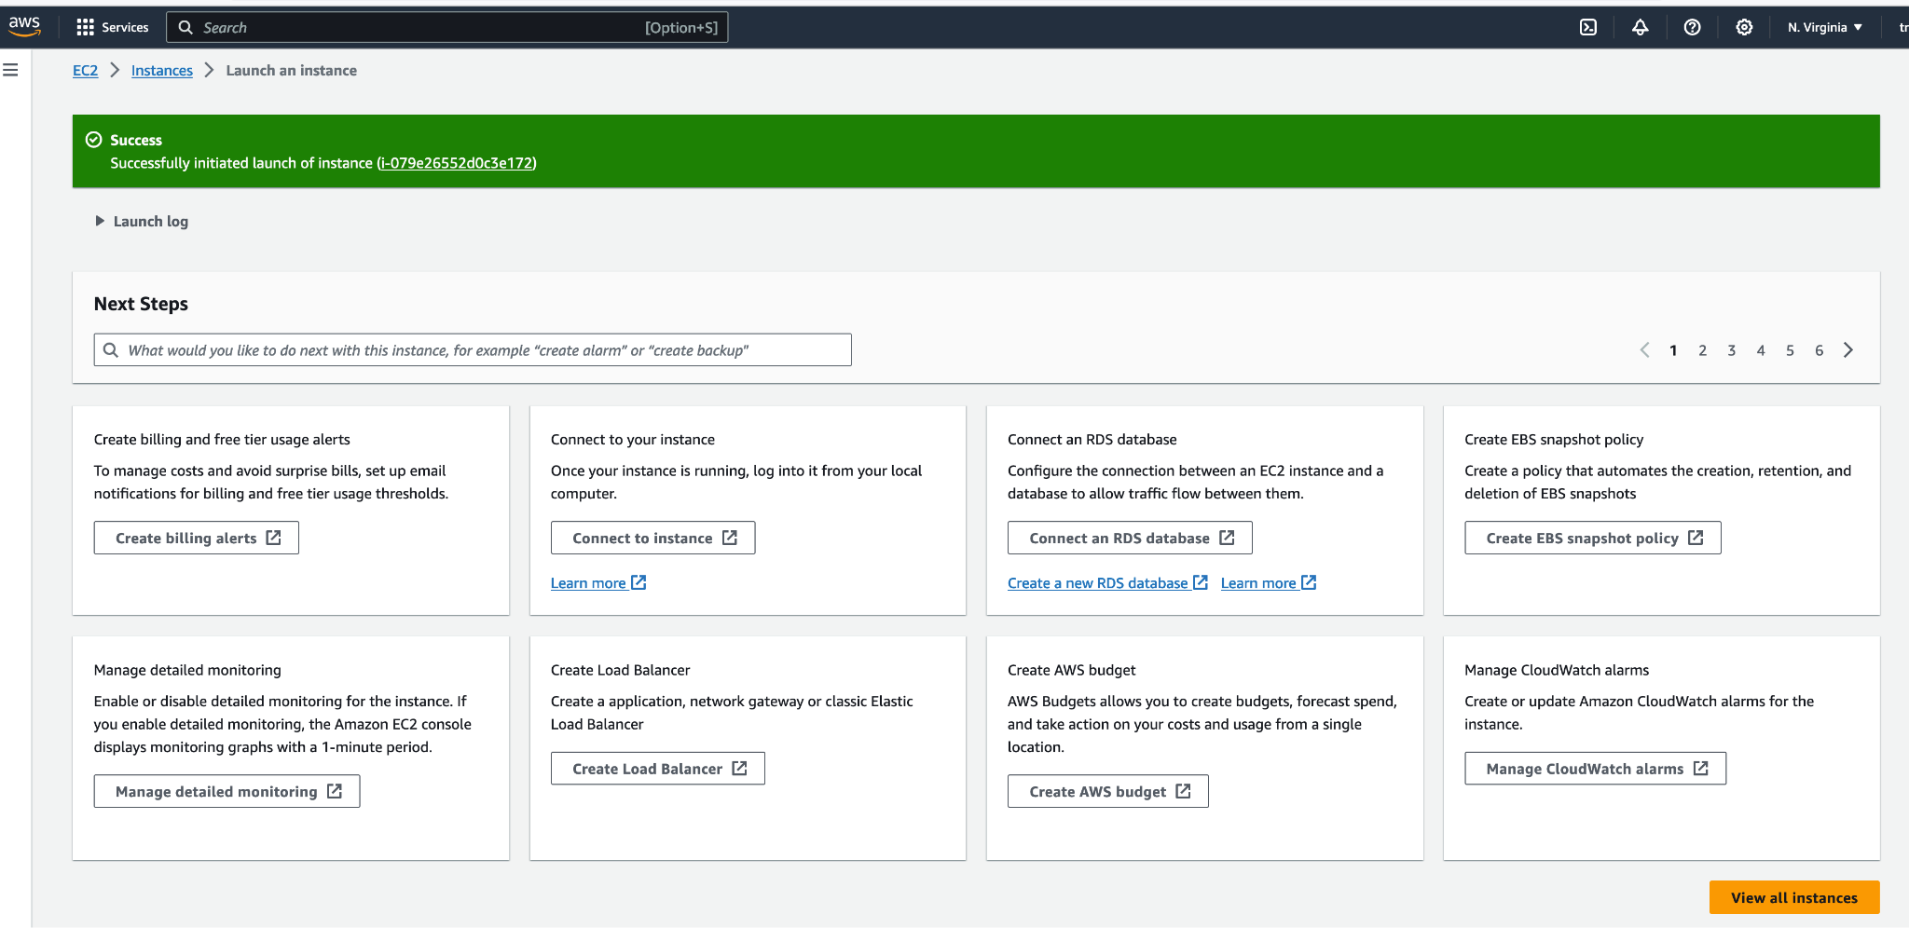
How to create a master AMI for ansible
Select the key
Click here
18

Slide 16
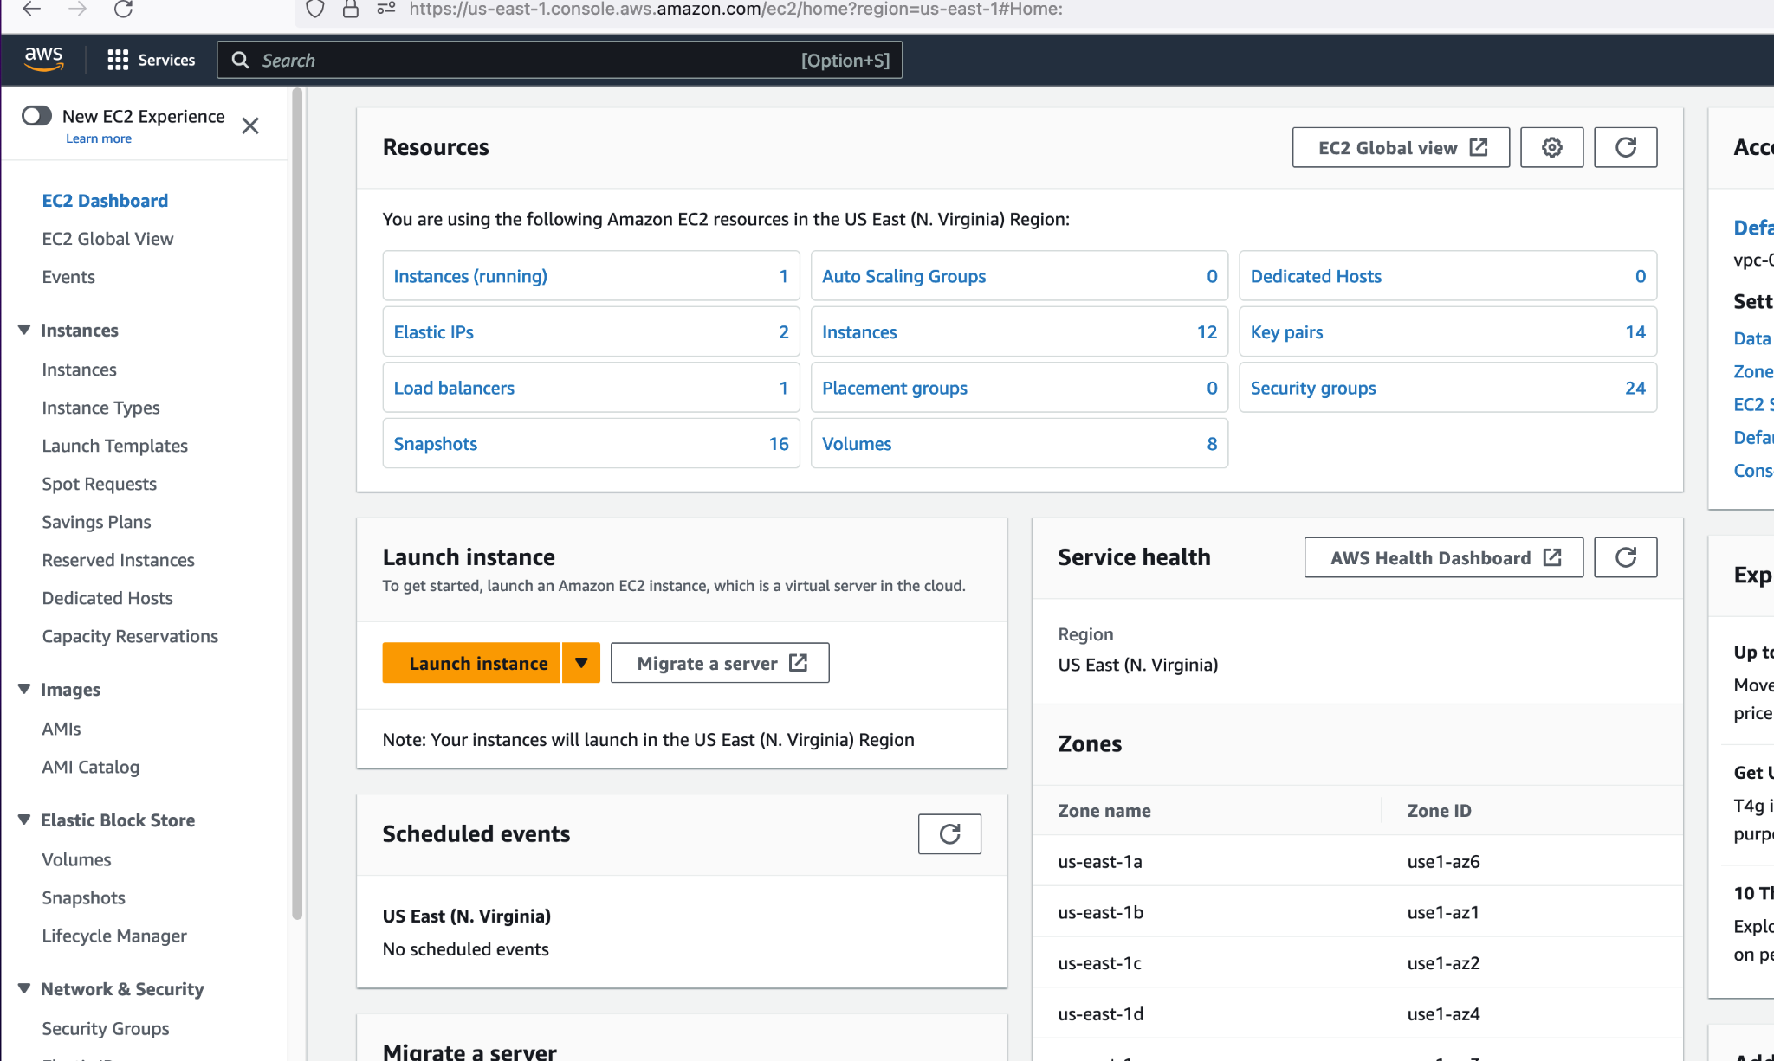
How to create a master AMI for ansible
Click here
20
Click here
19

Slide 17
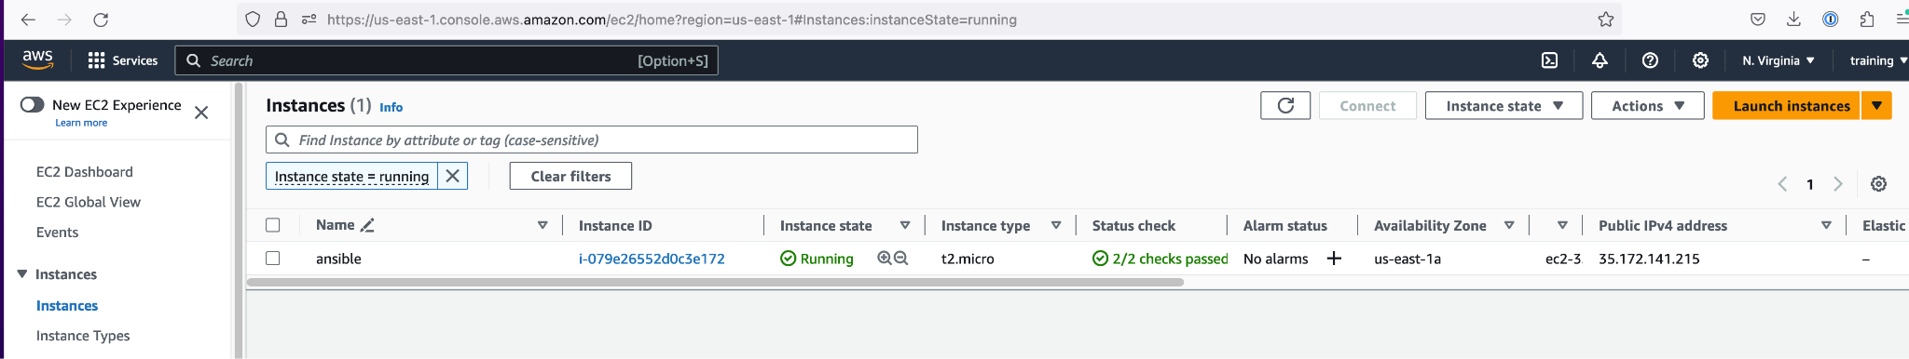
How to create a master AMI for ansible
Click here
21

Slide 18
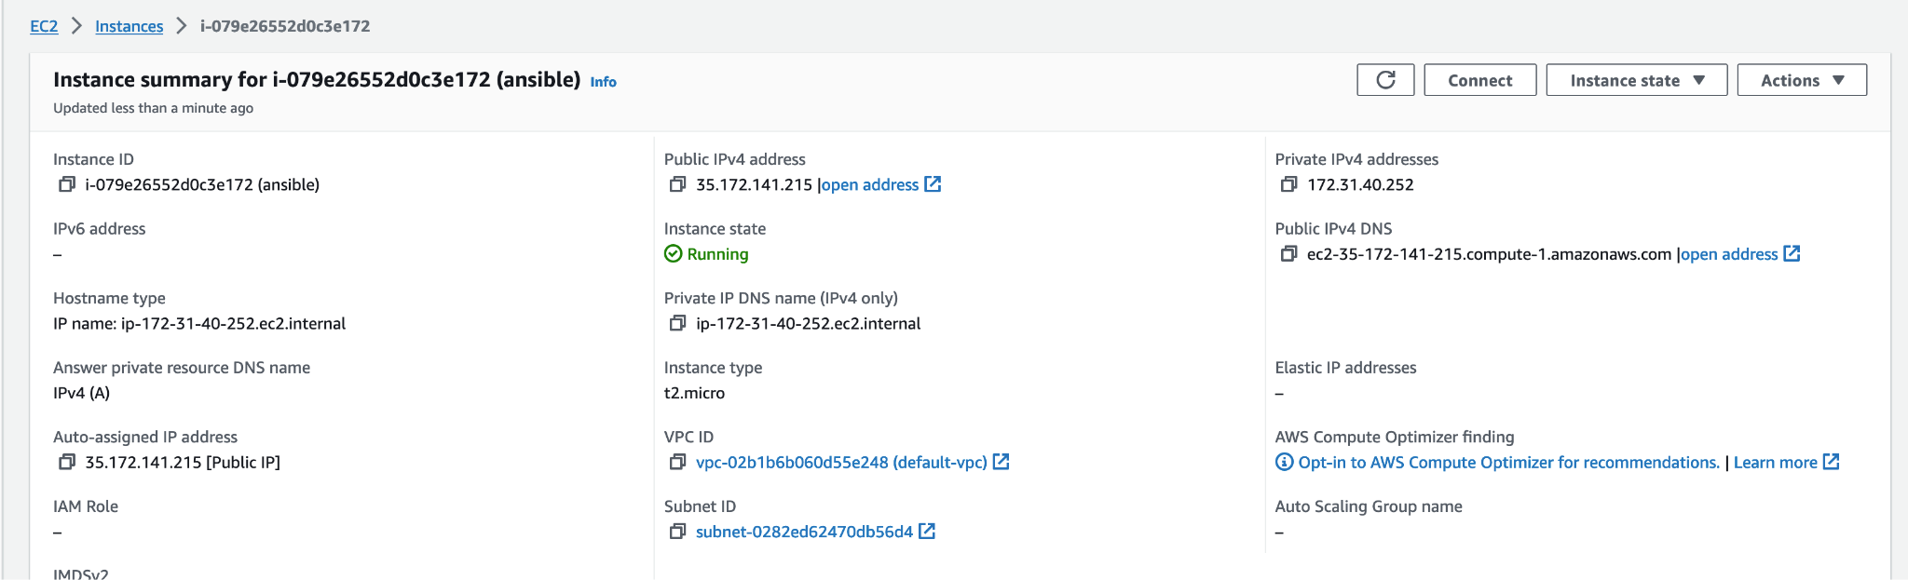
How to create a master AMI for ansible
Click here
22

Slide 19
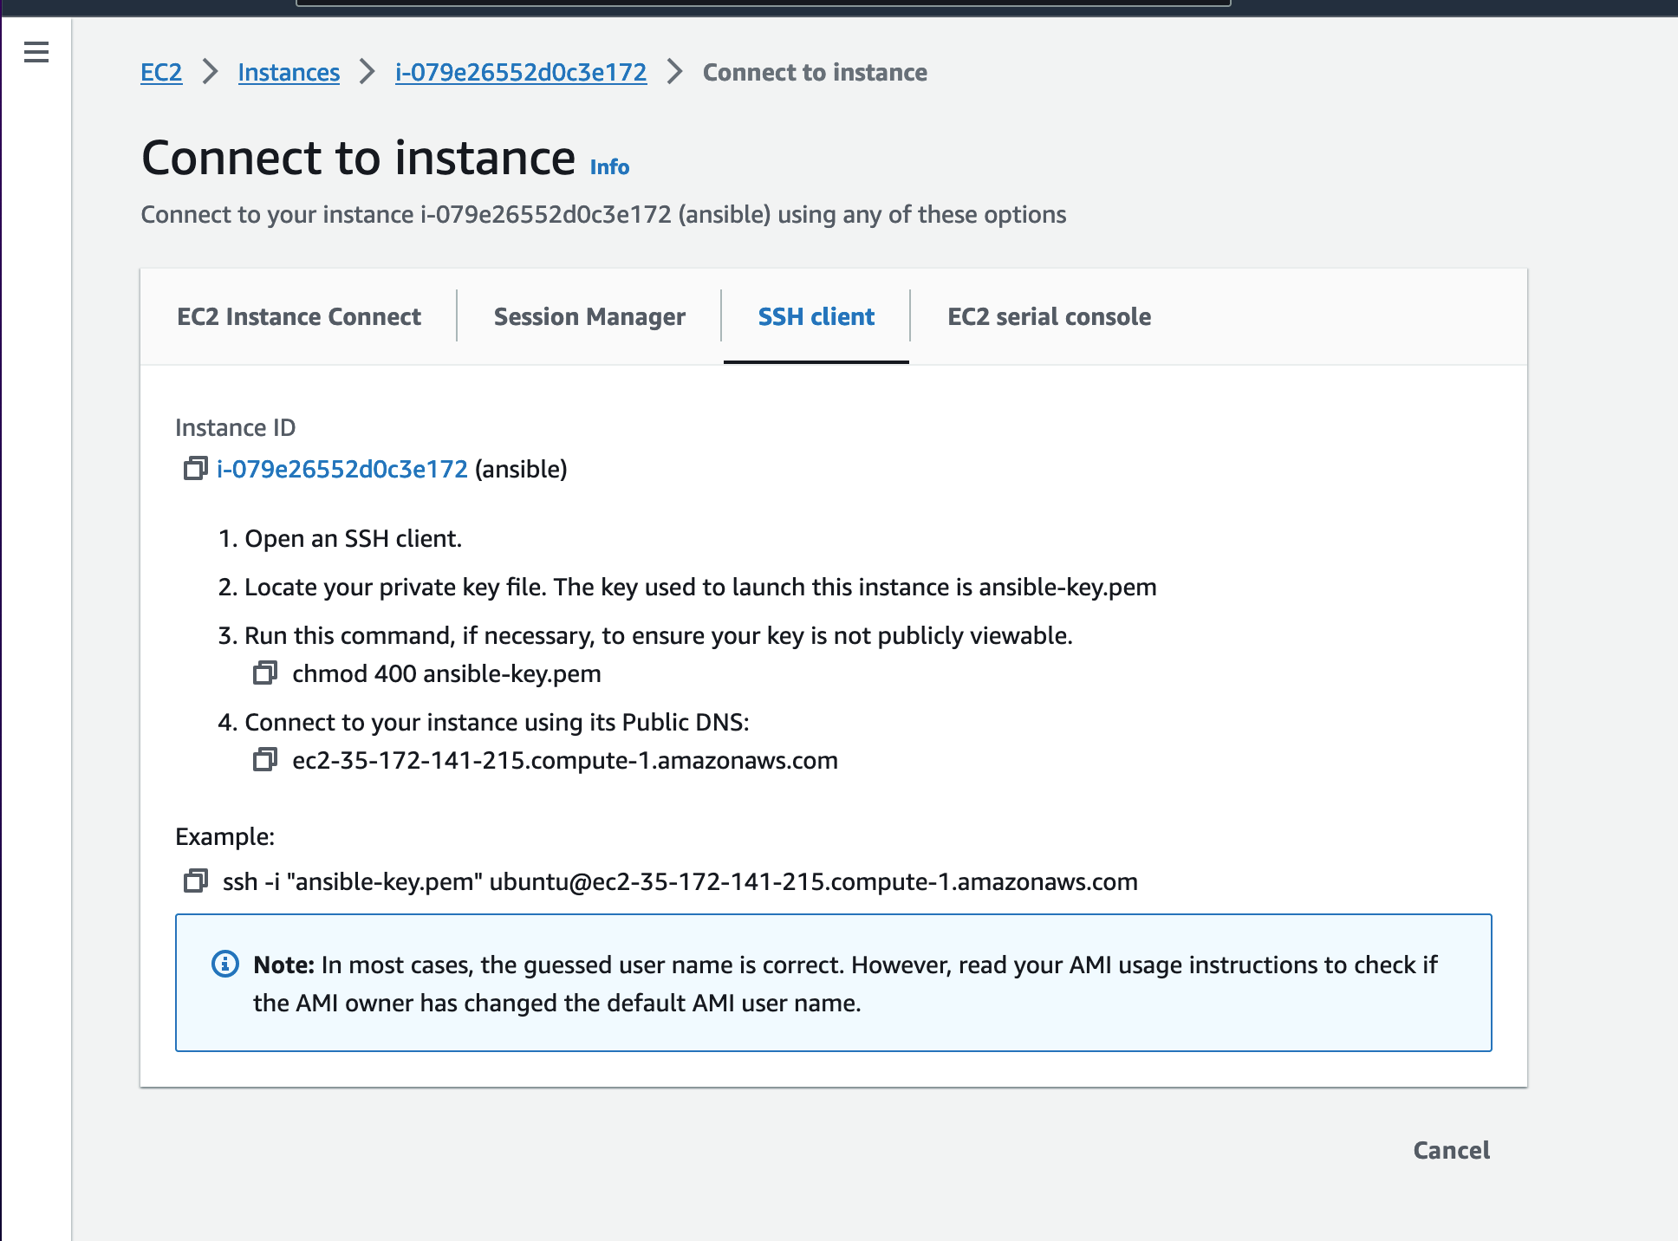
How to create a master AMI for ansible
Click here
23
$ cd ~/Downloads
$ chmod 400 ansible-key.pem
$ ssh -i "ansible-key.pem" ubuntu@ec2-35-172-141-215.compute-1.amazonaws.com
Click here
24
25
26
Click here
Run the command above

Slide 20
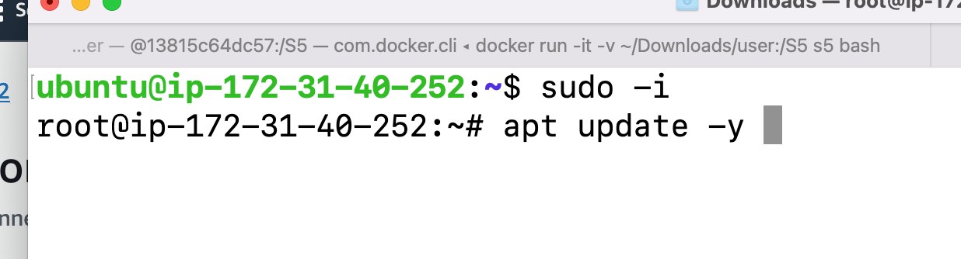
How to create a master AMI for ansible
Click here
27
Click here
24
28

Slide 21
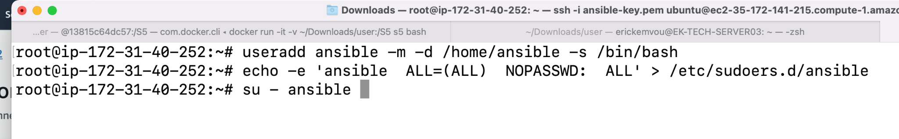
How to create a master AMI for ansible
Click here
29
$ useradd ansible -m -d /home/ansible -s /bin/bash
$ echo -e 'ansible ALL=(ALL) NOPASSWD: ALL' > /etc/sudoers.d/ansible
$ su - ansible

Slide 22
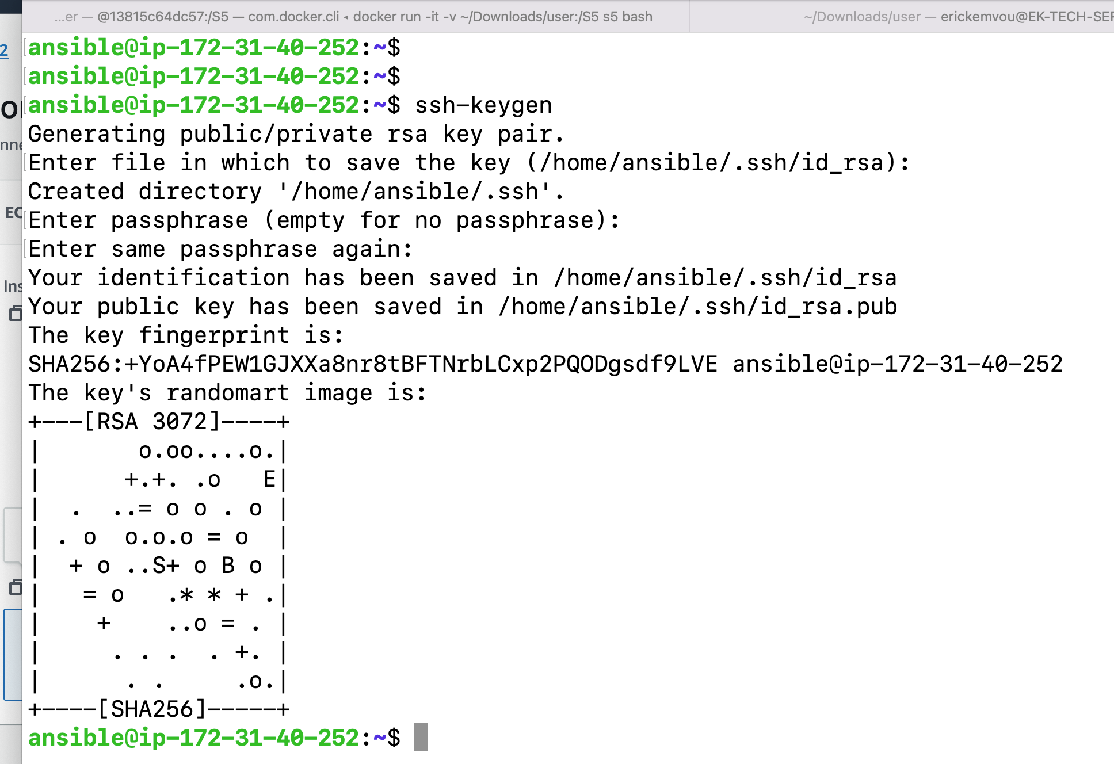
How to create a master AMI for ansible
Click here
30
Keep typing enter your keyboard until the key is generated
$ ssh-keygen

Slide 23
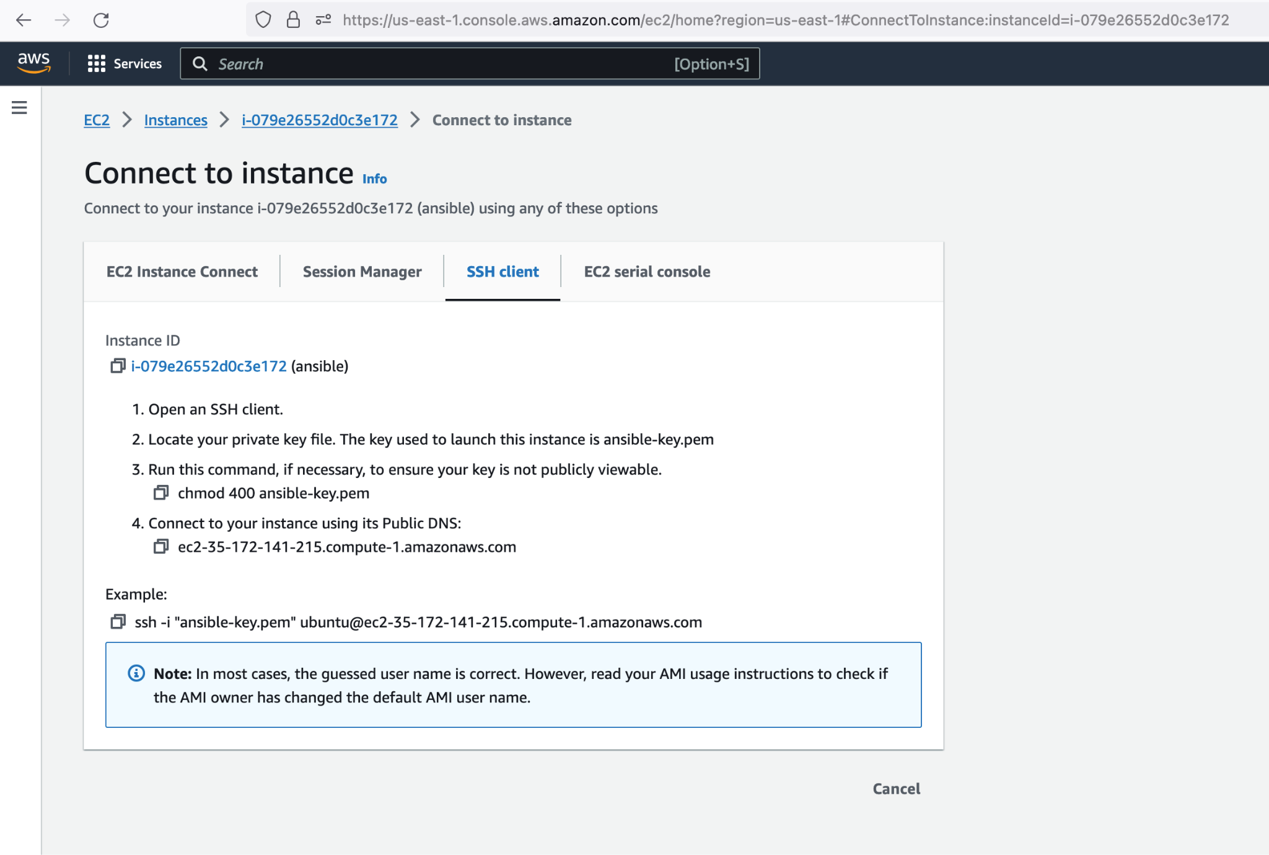
How to create a master AMI for ansible
31
Click here

Slide 24
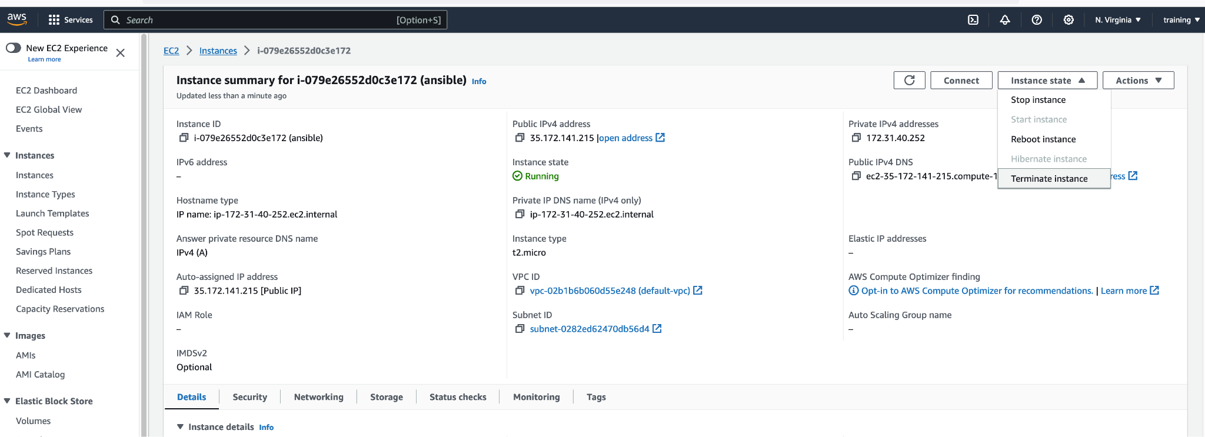
How to create a master AMI for ansible
32
Click here
33
Click here

Slide 25
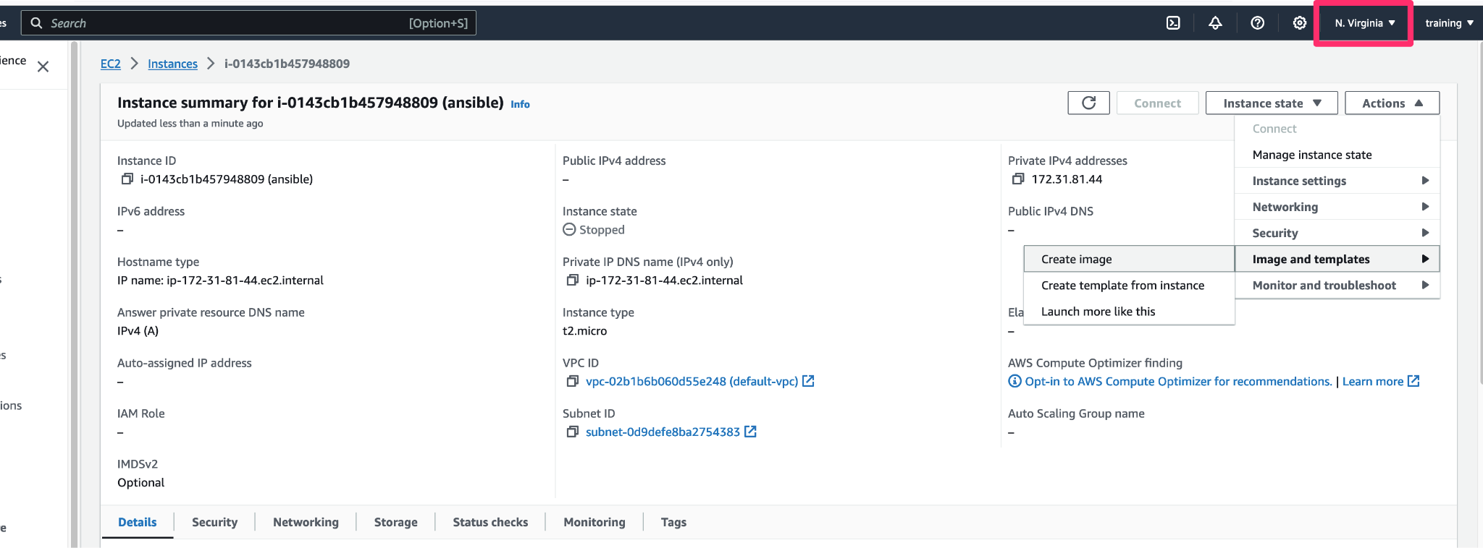
How to create a master AMI for ansible
34
Click here
36
Click here
Click here
35
Click here

Slide 26
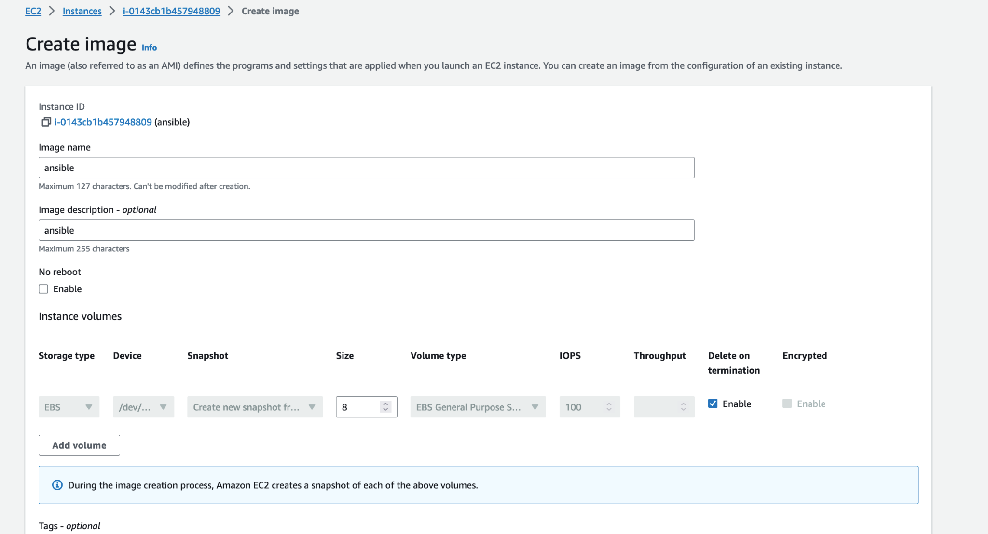
How to create a master AMI for ansible
37
Enter name
36
Click here
Click here
38
Enter the description

Slide 27
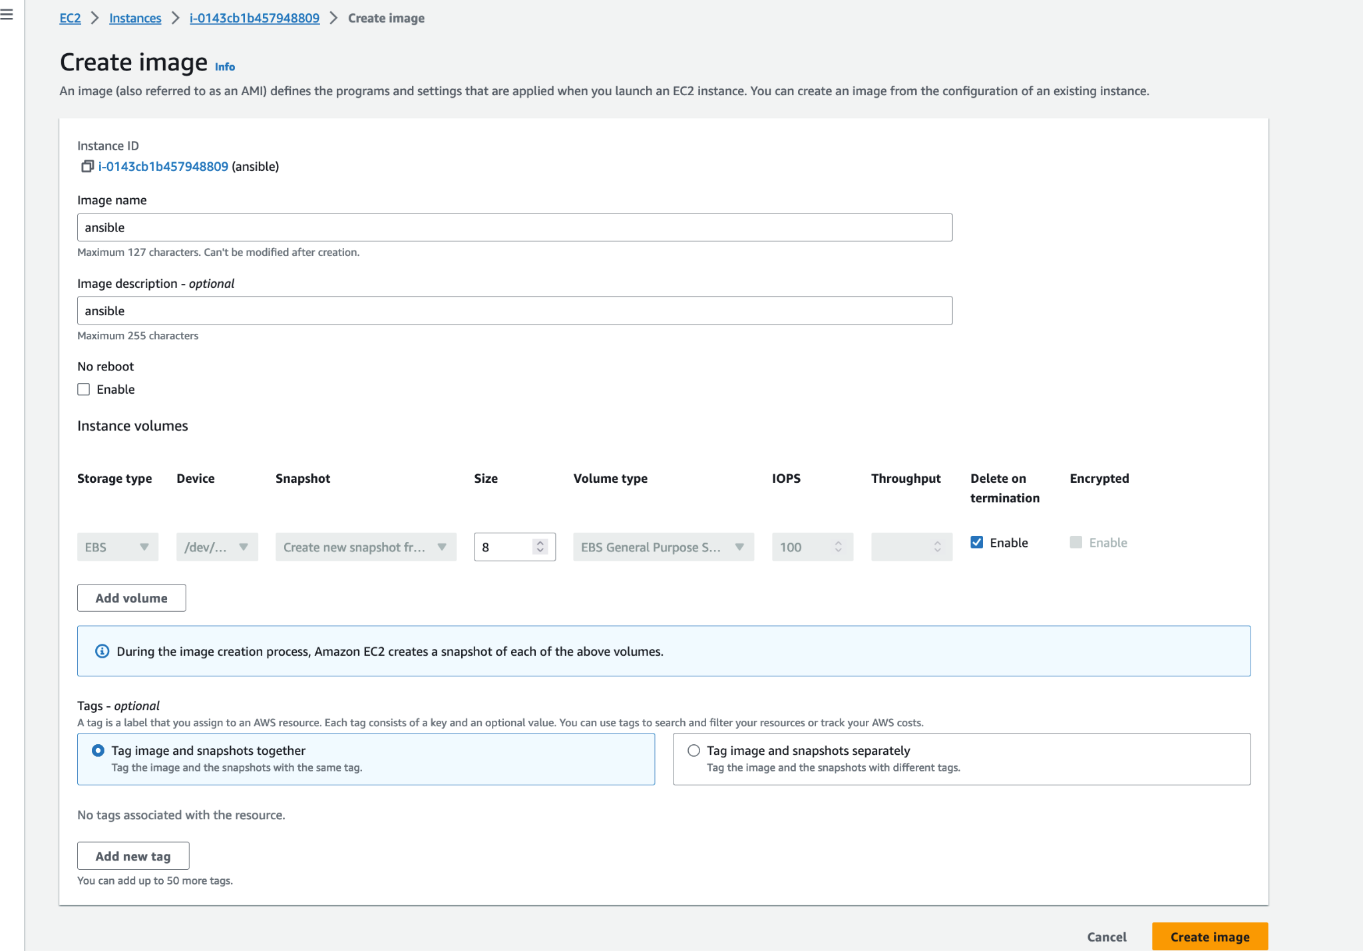
How to create a master AMI for ansible
37
Enter name
38
Enter the description
39
Click there

Slide 28
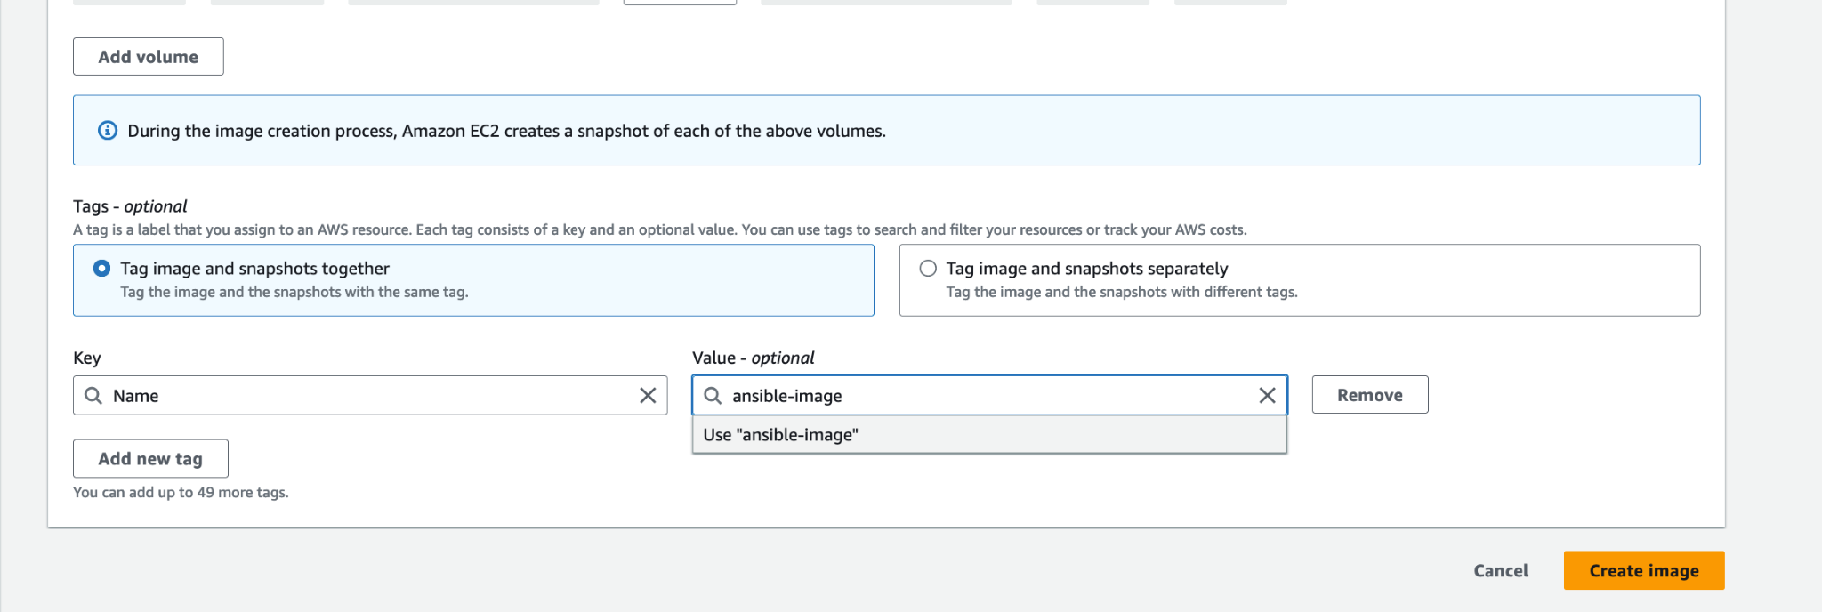
How to create a master AMI for ansible
Enter Name
40
41
Enter ansible-image
42
Click there

Slide 29


How to create a master AMI for ansible

Slide 30
STATIC INVENTORY

Slide 31
Key points about Ansible inventory
Static Inventory:
A static inventory is the traditional way of defining the hosts and groups in a plaintext file (by default, /etc/ansible/hosts). In this file, you can specify individual hostnames or IP addresses, and you can also define groups of hosts and even group variables.
Here's a simple example of a static inventory:

Slide 32
How to create ansible static inventory
For this example we are going to create 1 master node and 5 target node with the image we previously created

Slide 33

1
Login to

Slide 34
How to set up dynamic inventory
2
3
Select EC2
Click on service
4
Enter EC2

Slide 35
How to set up dynamic inventory
2
4
Select EC2
Click on service
3
Enter EC2

Slide 36
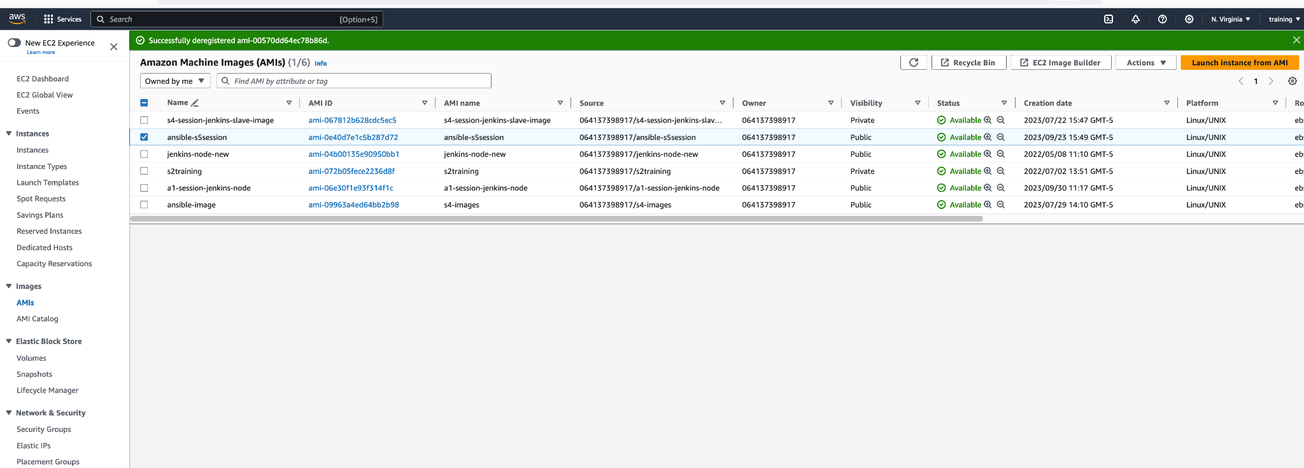
How to set up dynamic inventory
Click here
6
Please make sure to select the image you created previously
7
Click here
5

Slide 37
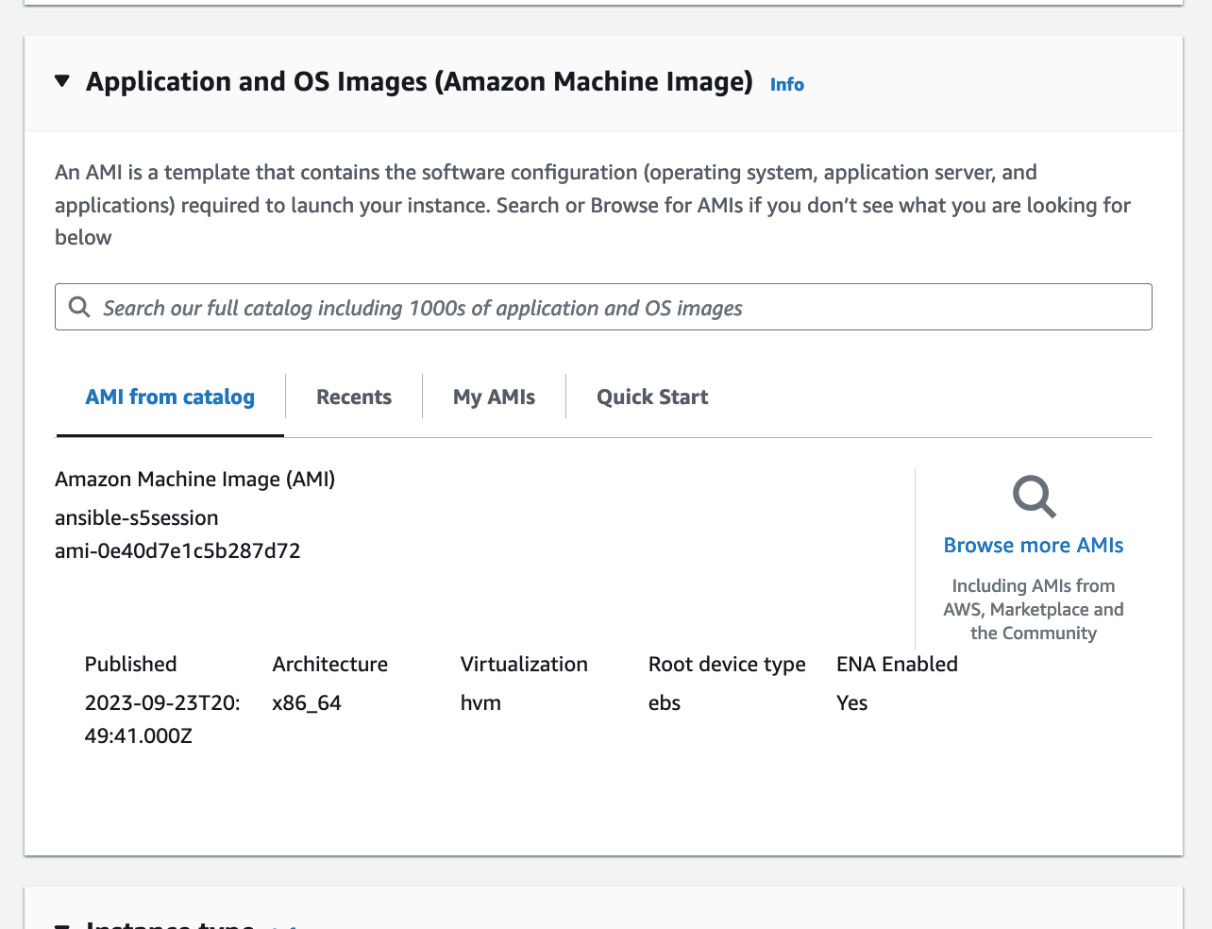
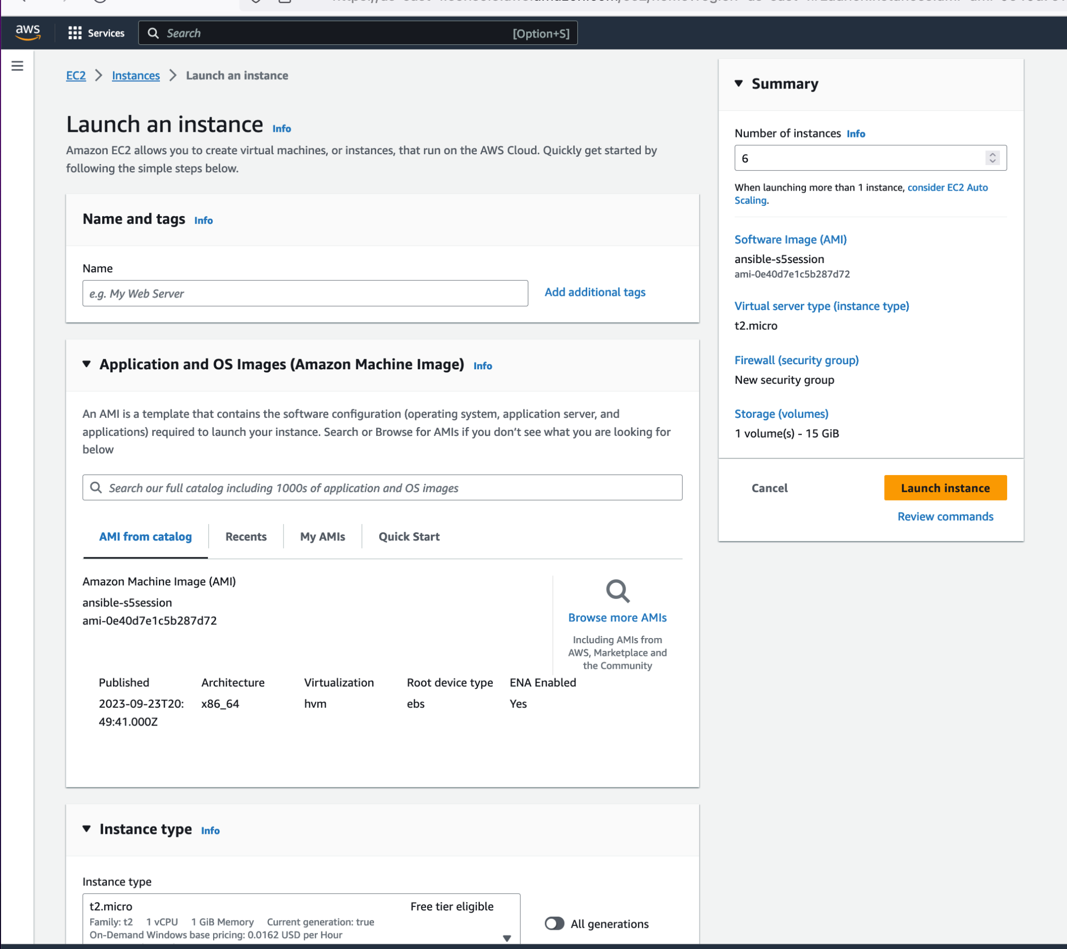
How to set up dynamic inventory
8
Create instance as previously shown on others slide but this time around enter 6 here to create 6 instances at the same time
6
Please make sure to select the image you created previously
This comes by default do not change

Slide 38
How to create a master AMI for ansible
Click here
10
Click here
9

Slide 39
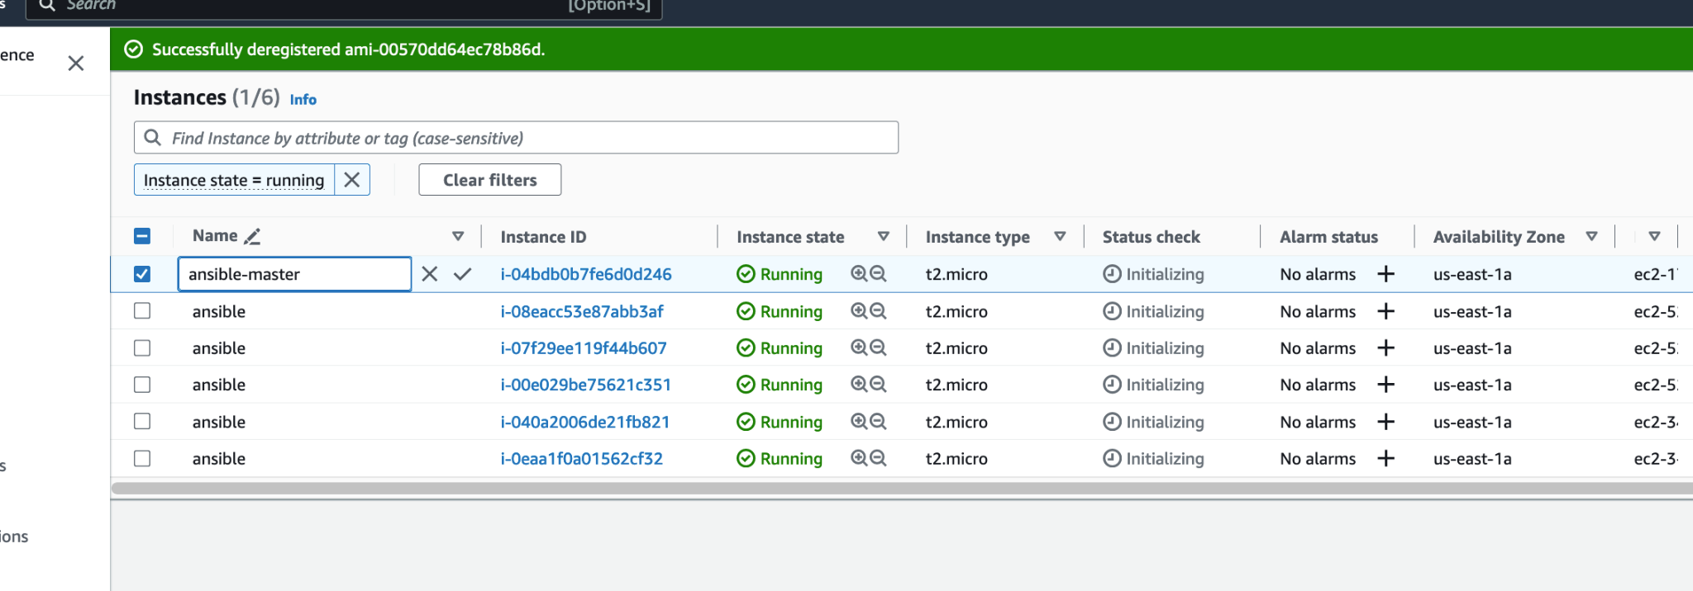
How to create a master AMI for ansible
Click here to rename each VM make sure to elect one ast ansible-master
11
12
validate
Repeat the process for each VM

Slide 40
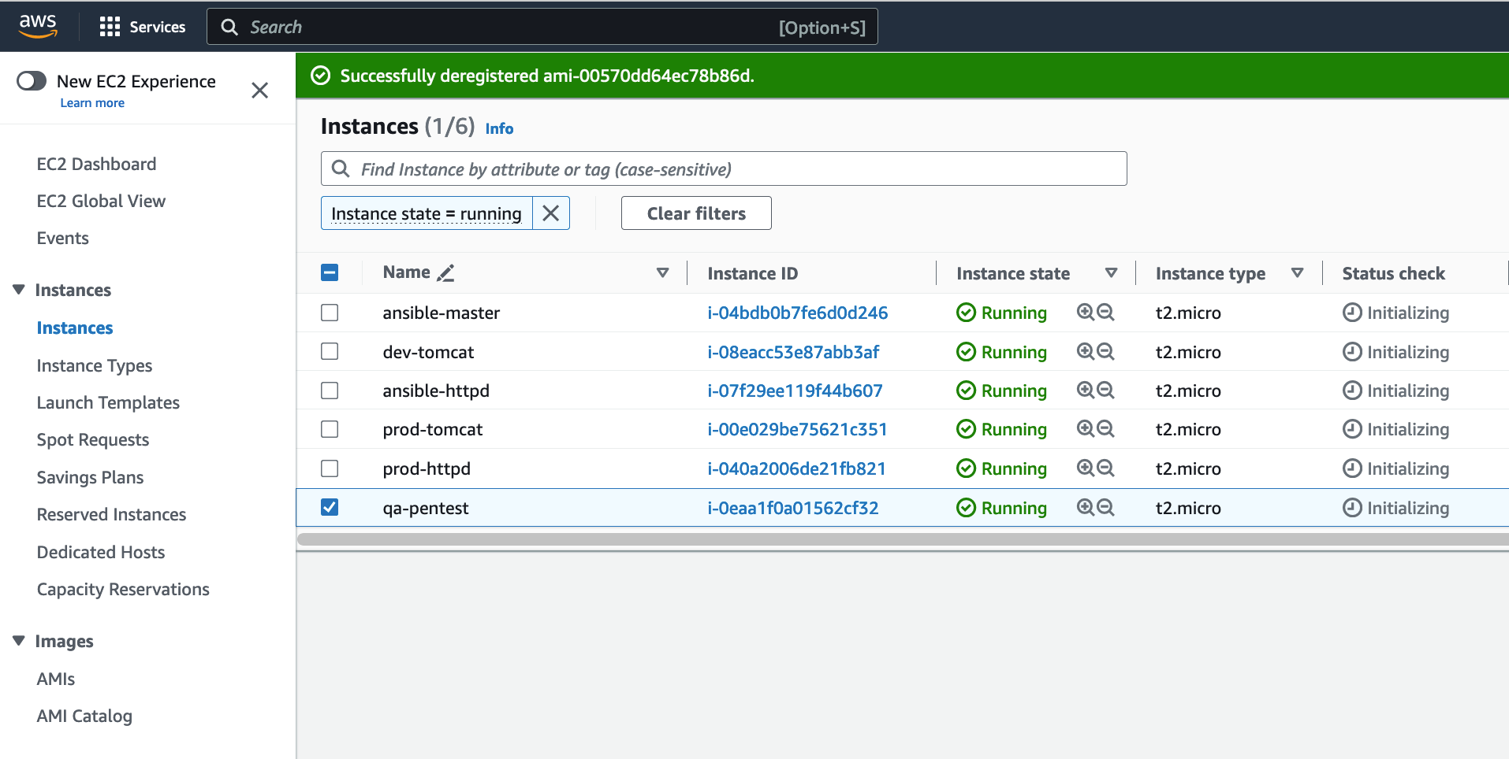
How to create a master AMI for ansible
Look at mine I am a fancy guy
Looooooool

Slide 41
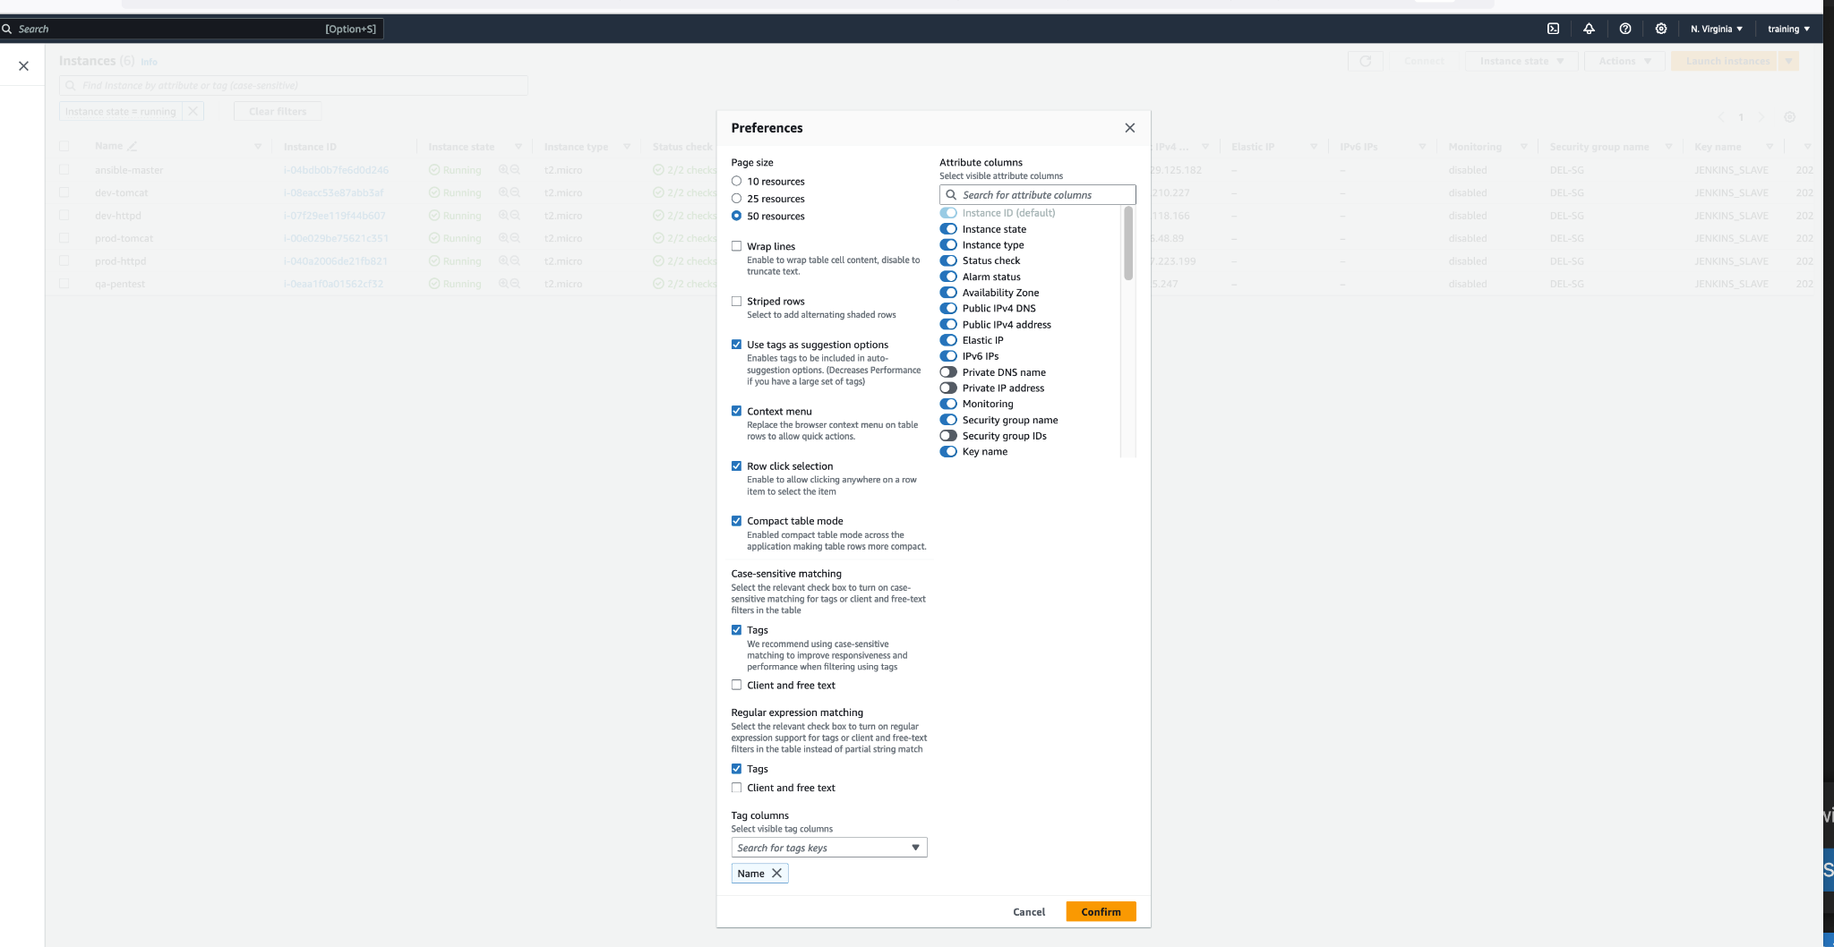
How to create a master AMI for ansible
13
Click on the wheel
14
Mimic this configuration
15

Slide 42
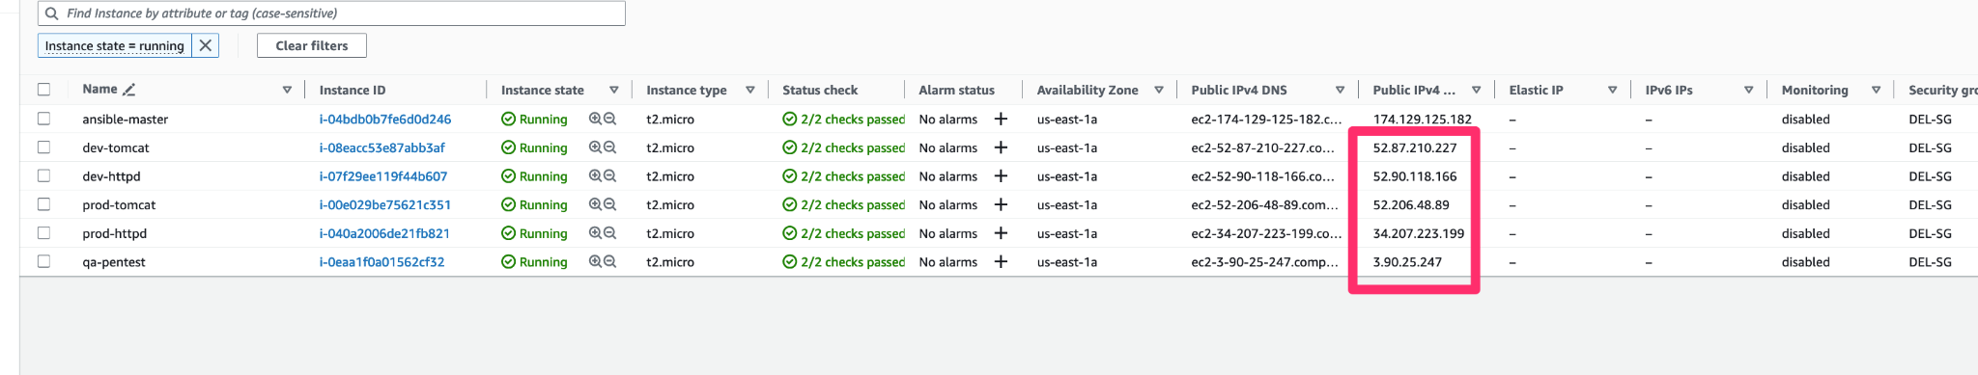
How to create a master AMI for ansible
16
Copy each of these IP address
14
Mimic this configuration
Notice that I did not copy the ansible-master IP address

Slide 43
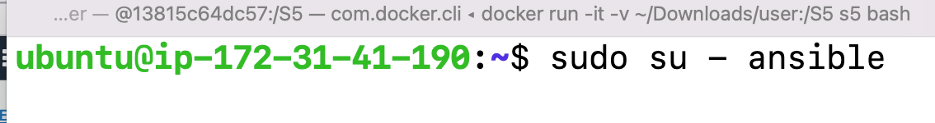
LOGIN TO THE ANSIBLE-MASTER
VM
Make sure to use ubuntu as user when you want to login
Then switch user to ansible

Slide 44
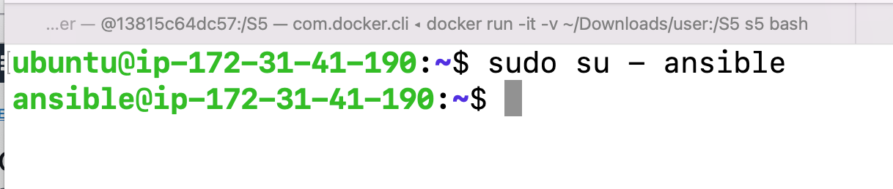
LOGIN TO THE ANSIBLE-MASTER
VM
Make sure to use ubuntu as user when you want to login
Then switch user to ansible

Slide 45
ansible.cfg
[defaults]
inventory = /home/ansible/static-inventory/inventory/inventory.yml
private_key_file = /home/ansible/.ssh/id_rsa
host_key_checking = False
ansible_connection=ssh
ansible_ssh_user=ansible

Slide 46
ansible.cfg
##### ANSIBLE STATIC SAMPLE INVENTORY FILE
##### Declare all target host
dev-tomcat ansible_host=52.87.210.227
dev-httpd ansible_host=52.90.118.166
prod-tomcat ansible_host=52.206.48.89
prod-httpd ansible_host=34.207.223.199
qa-pentest ansible_host=3.90.25.247
[TOMCAT]
dev-tomcat
prod-tomcat
[HTTPD]
dev-httpd
prod-httpd
[QA]
qa-pentest
Really did you just say that Eric this is not working
Come on
These servers have been terminated already in AWS
Please just follow the example with your own set of servers

Slide 47
ansible.sh file
#! /bin/bash
#### update
sudo apt update -y
#### install python
sudo apt install -y python3 python3-pip
# install ansible
curl https://bootstrap.pypa.io/get-pip.py -o get-pip.py
python3 get-pip.py --user
python3 -m pip install --user ansible
python3 -m pip install --user ansible-core
export PATH="$PATH:/home/ansible/.local/bin"
echo 'export PATH="$PATH:/home/ansible/.local/bin"' >> /home/ansible/.bashrc
source /home/ansible/.bashrc
# install boto3
pip3 install --user boto3
pip install boto3 botocore
/usr/bin/python3 -m pip install boto3 botocore

Slide 48
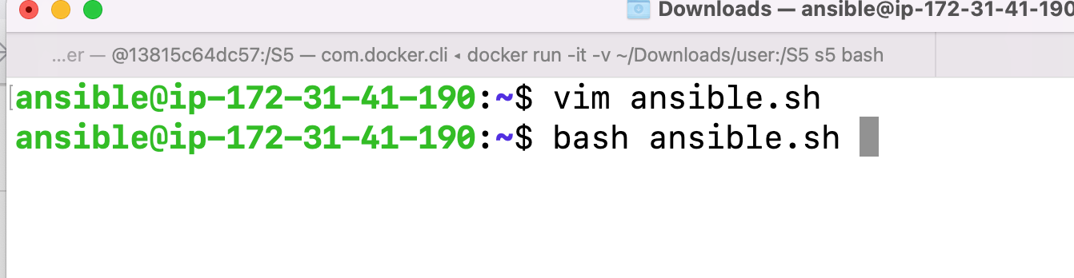
Create a script using the content on previous slide then run the script

Slide 49
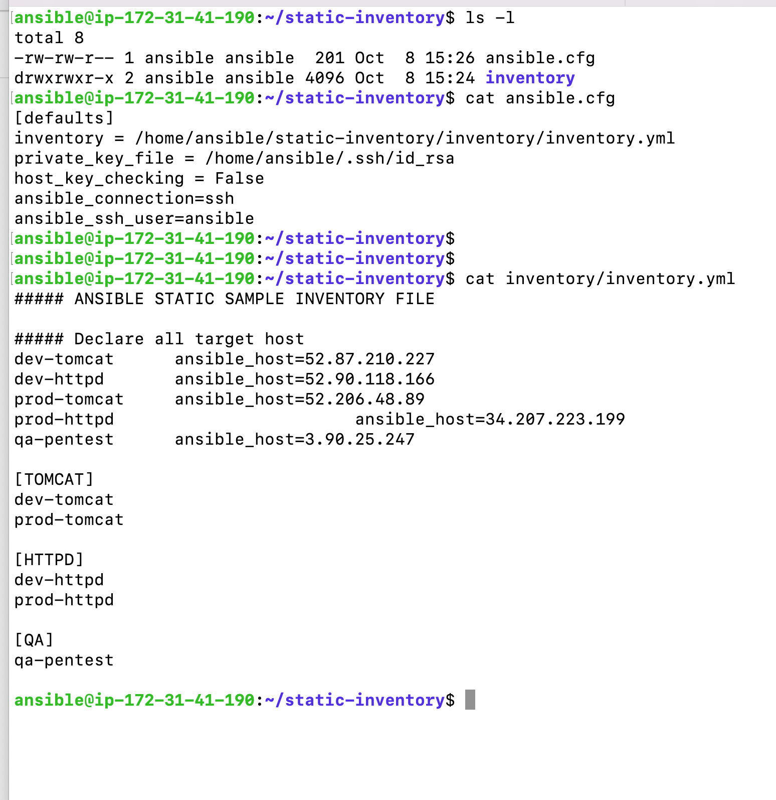

Slide 50
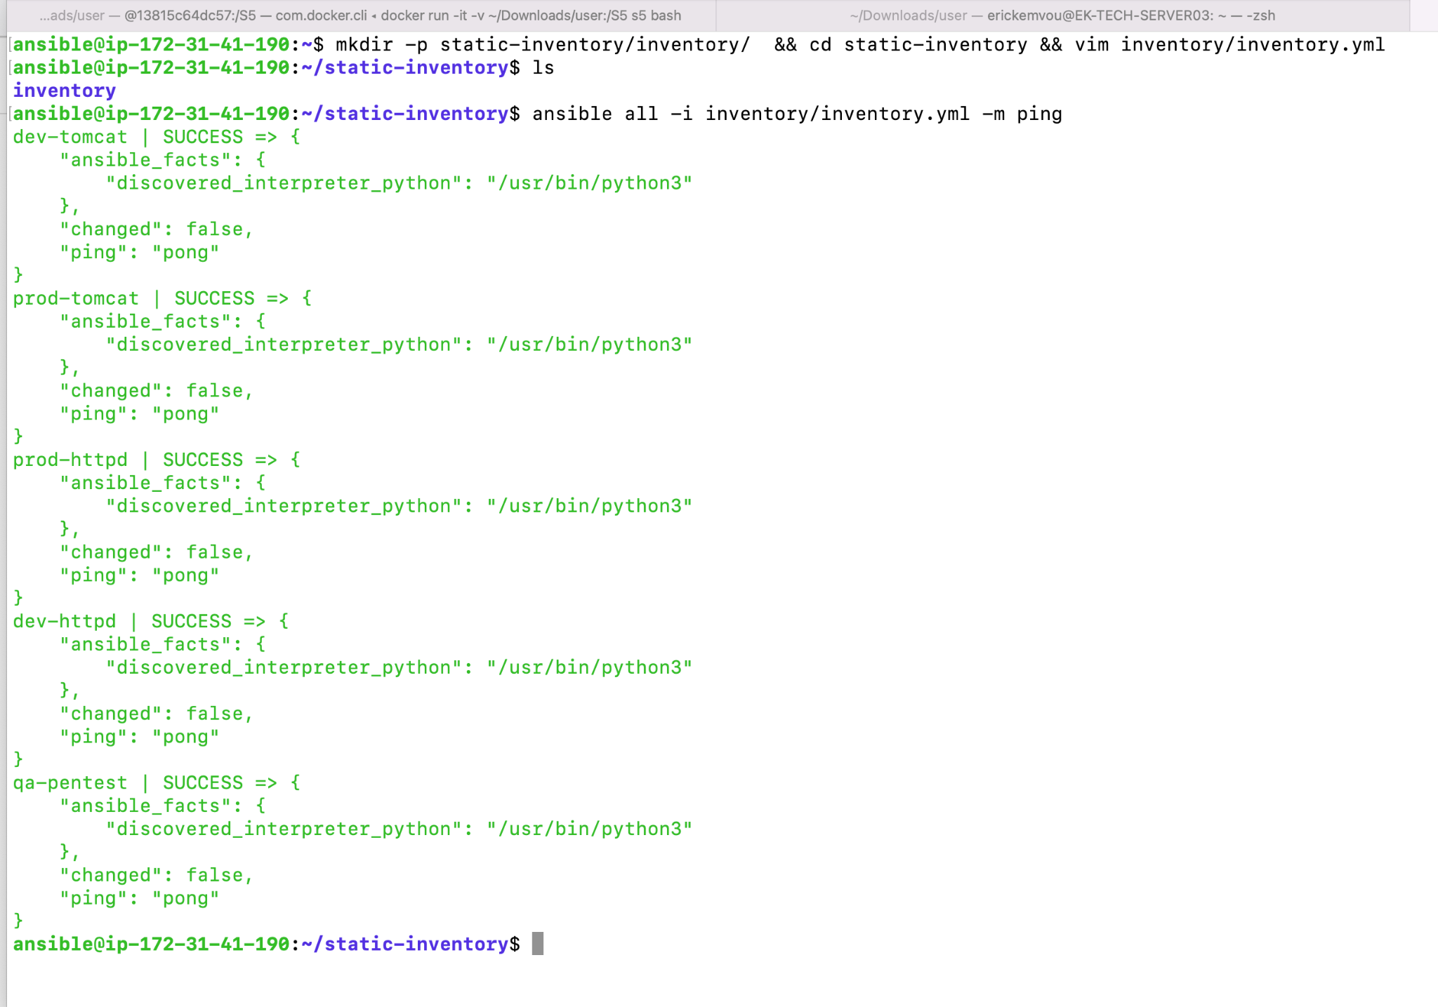

Slide 51
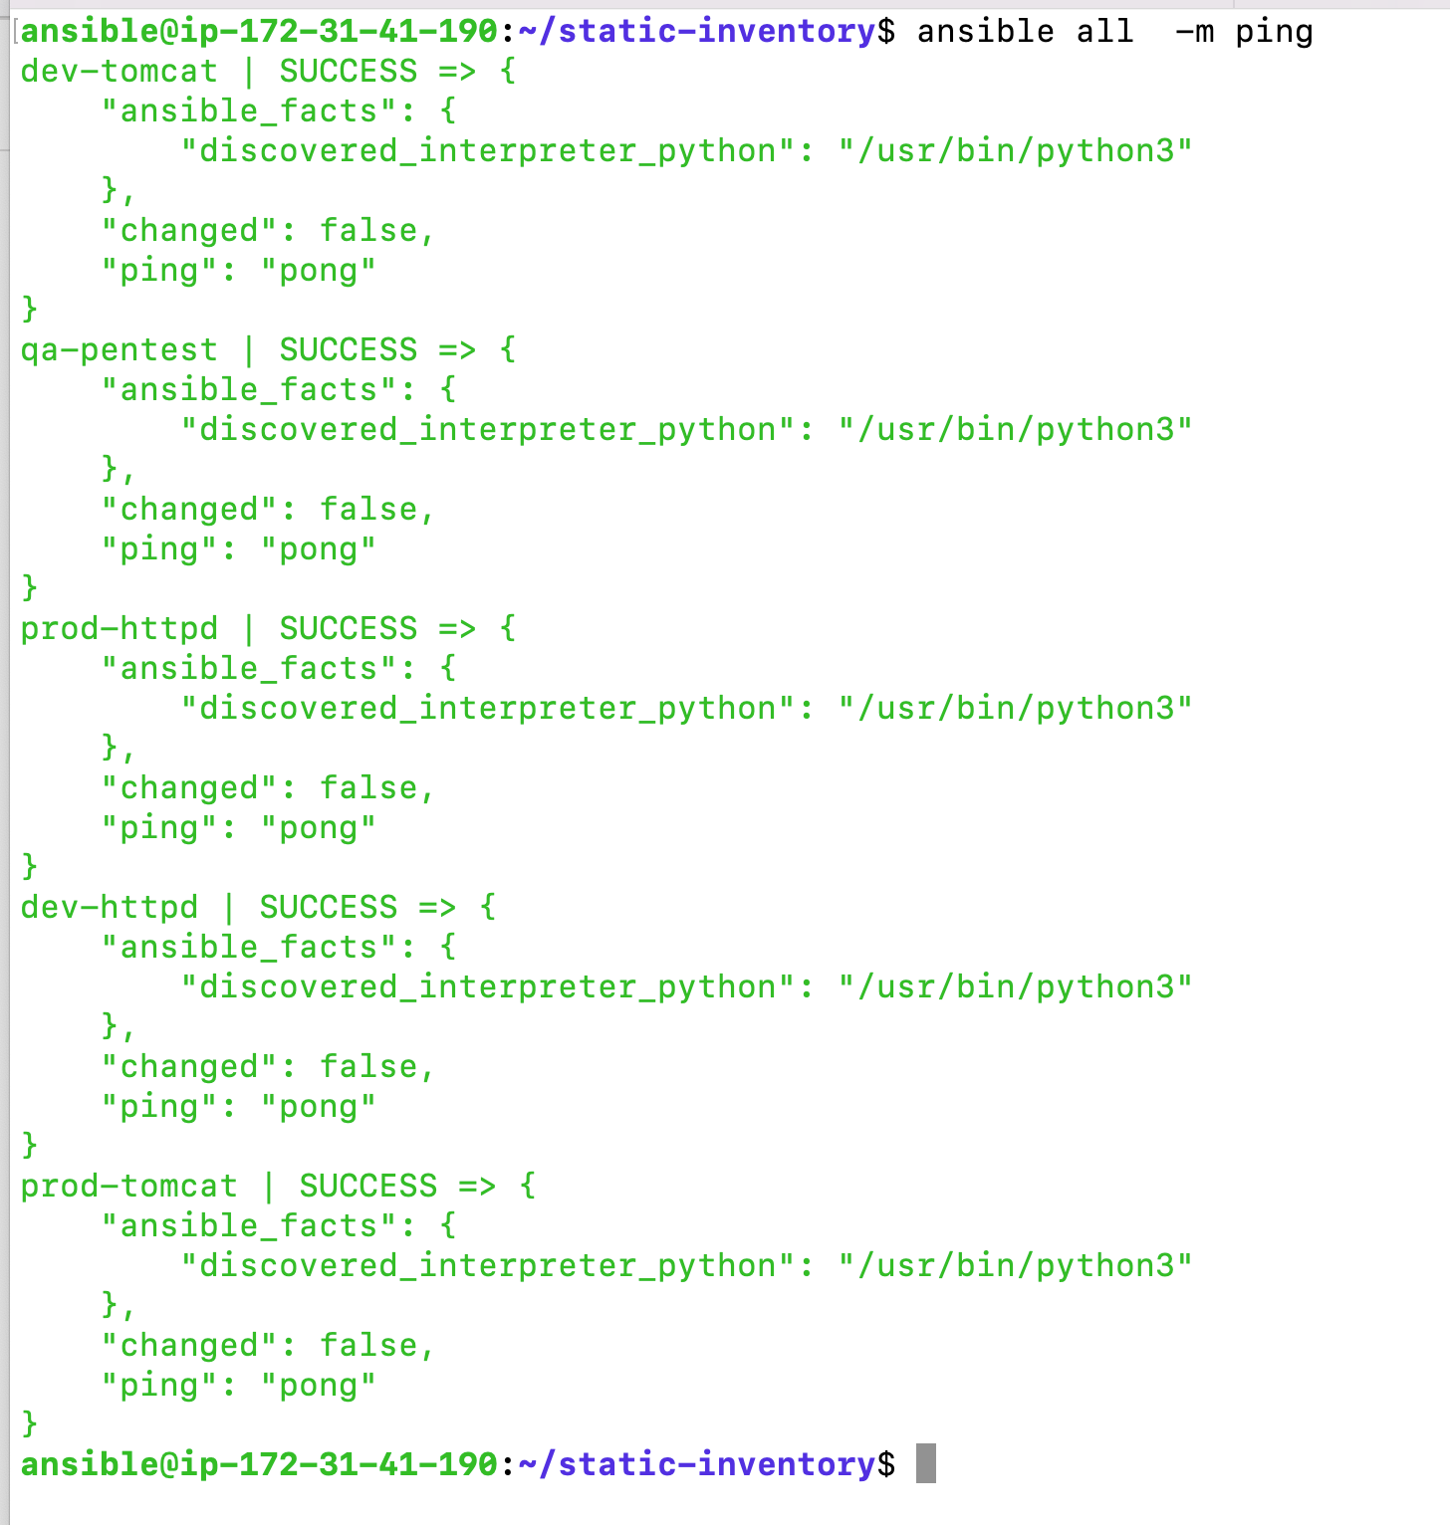

Slide 52
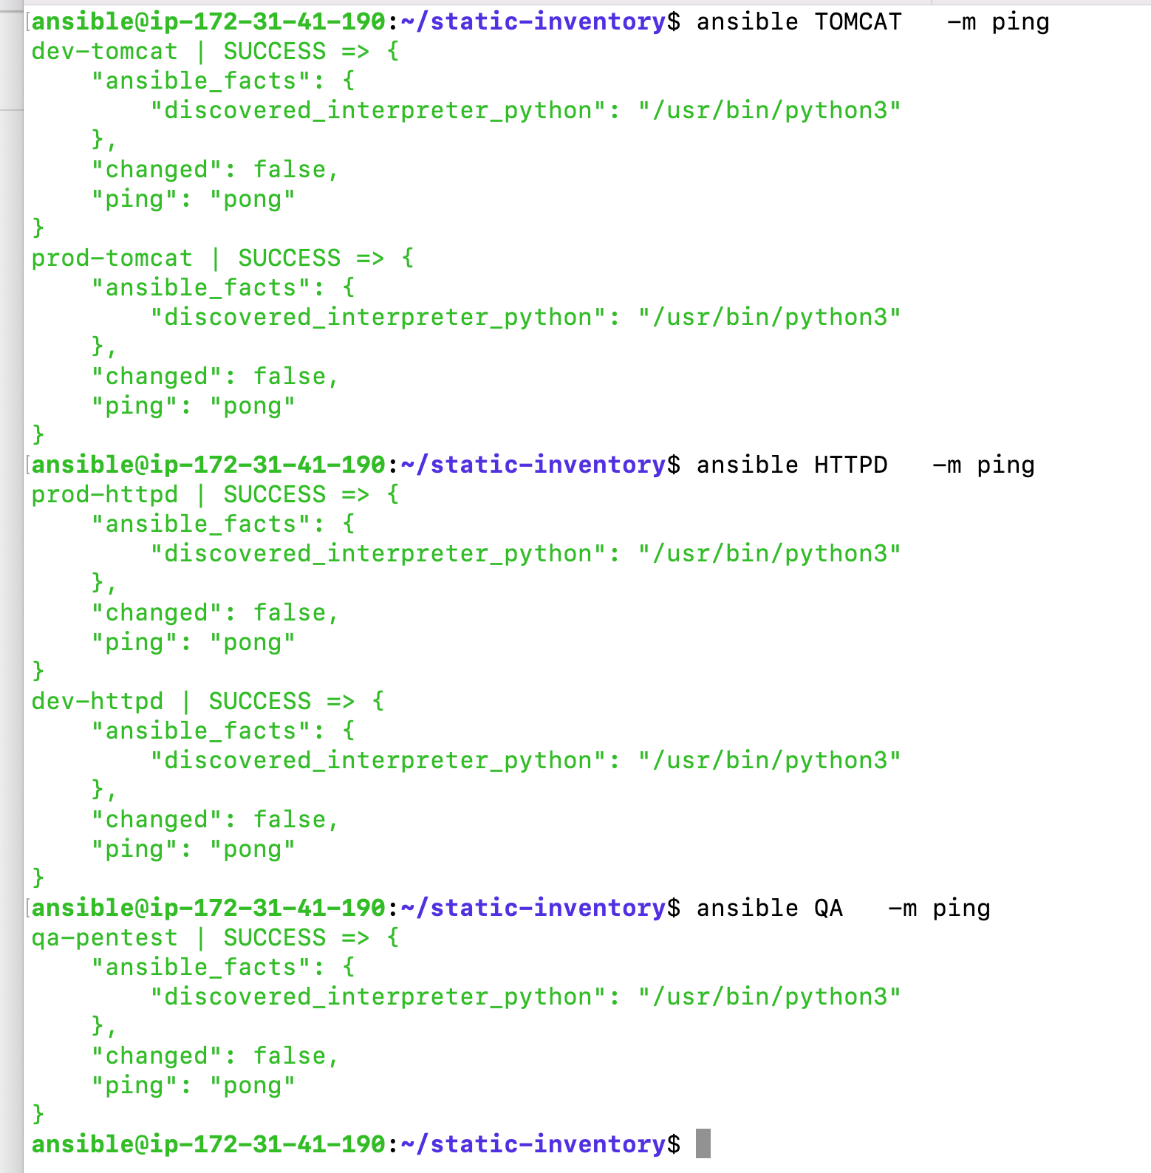

Slide 53

DYNAMIC INVENTORY

Slide 54
Key points about Ansible inventory
Dynamic inventory in Ansible refers to retrieving or generating an inventory list (a list of hosts that Ansible can act upon) dynamically rather than keeping a static list in a file.
This is especially useful in cloud environments, where the number of hosts or their IP addresses and other attributes might change frequently due to auto-scaling, frequent deployments, etc.

Slide 55
Key Points About Dynamic Inventory
Source of Truth: With dynamic inventory, the source of truth about available hosts shifts from a manually maintained file to an external system or source, such as a cloud provider's API, a database, or a Configuration Management Database (CMDB).
Scripts & Plugins: Initially, Ansible used Python scripts to fetch dynamic inventory. When you ran these scripts with the --list argument, they returned a JSON structure representing the inventory. Ansible 2.4 introduced inventory plugins which are more flexible and efficient than the older scripts.
Cloud Integration: One of the most common uses of dynamic inventory is to integrate with cloud providers like AWS, Azure, GCP, etc. This allows Ansible to automatically recognize and manage instances as they come up or go down.
Customization: Even if you're not using a major cloud provider, you can create your own dynamic inventory scripts or plugins to pull host information from other sources, such as a custom database or an API.
Combining Static & Dynamic: Ansible allows combining static and dynamic inventory sources. This can be helpful in hybrid environments where some hosts are fixed, and others are dynamic.
Caching: Dynamic inventory results can be cached to improve performance. This ensures that if you run several Ansible commands in quick succession, Ansible doesn't need to fetch the entire inventory from the external source every time.

Slide 56
How to create ansible dynamic inventory
For this example we are going to create 1 master node and 5 target node with the image we previously created

Slide 57
1
Login to

Slide 58
How to set up dynamic inventory
2
3
Select EC2
Click on service
4
Enter EC2

Slide 59
How to set up dynamic inventory
2
4
Select EC2
Click on service
3
Enter EC2

Slide 60
How to set up dynamic inventory
Click here
6
Please make sure to select the image you created previously
7
Click here
5

Slide 61
How to set up dynamic inventory
8
Create instance as previously shown on others slide but this time around enter 6 here to create 6 instances at the same time
6
Please make sure to select the image you created previously
This comes by default do not change

Slide 62
How to create a master AMI for ansible
Click here
10
Click here
9

Slide 63
How to create a master AMI for ansible
Click here to rename each VM make sure to elect one ast ansible-master
11
12
validate
Repeat the process for each VM

Slide 64
How to create a master AMI for ansible
Look at mine I am a fancy guy
Looooooool

Slide 65
How to create a master AMI for ansible
Now let us assign three tags ( TOMCAT, HTTPD, QA) to our VM on AWS
TOMCAT: dev-tomcat, prod-tomcat (APPS=TOMCAT)
HTTPD: dev-httpd, prod-httpd (APPS=HTTPD)
QA: qa-pentest (APPS=QA)
Look at mine I am a fancy guy
Looooooool

Slide 66
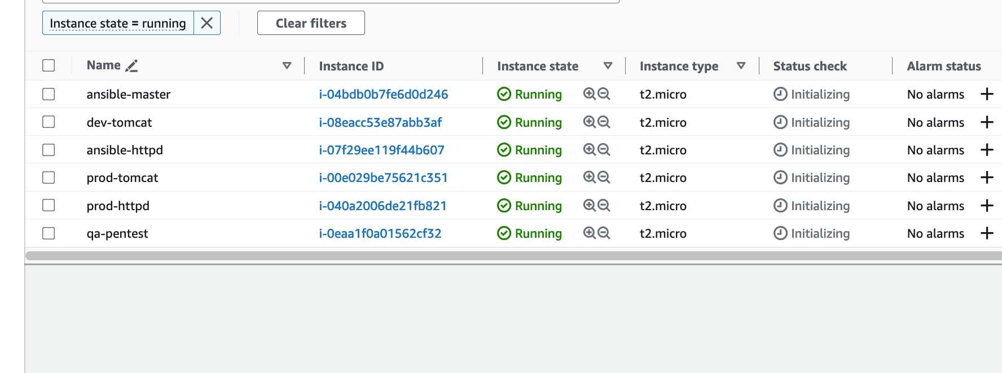
How to create a master AMI for ansible
Click here
10

Slide 67
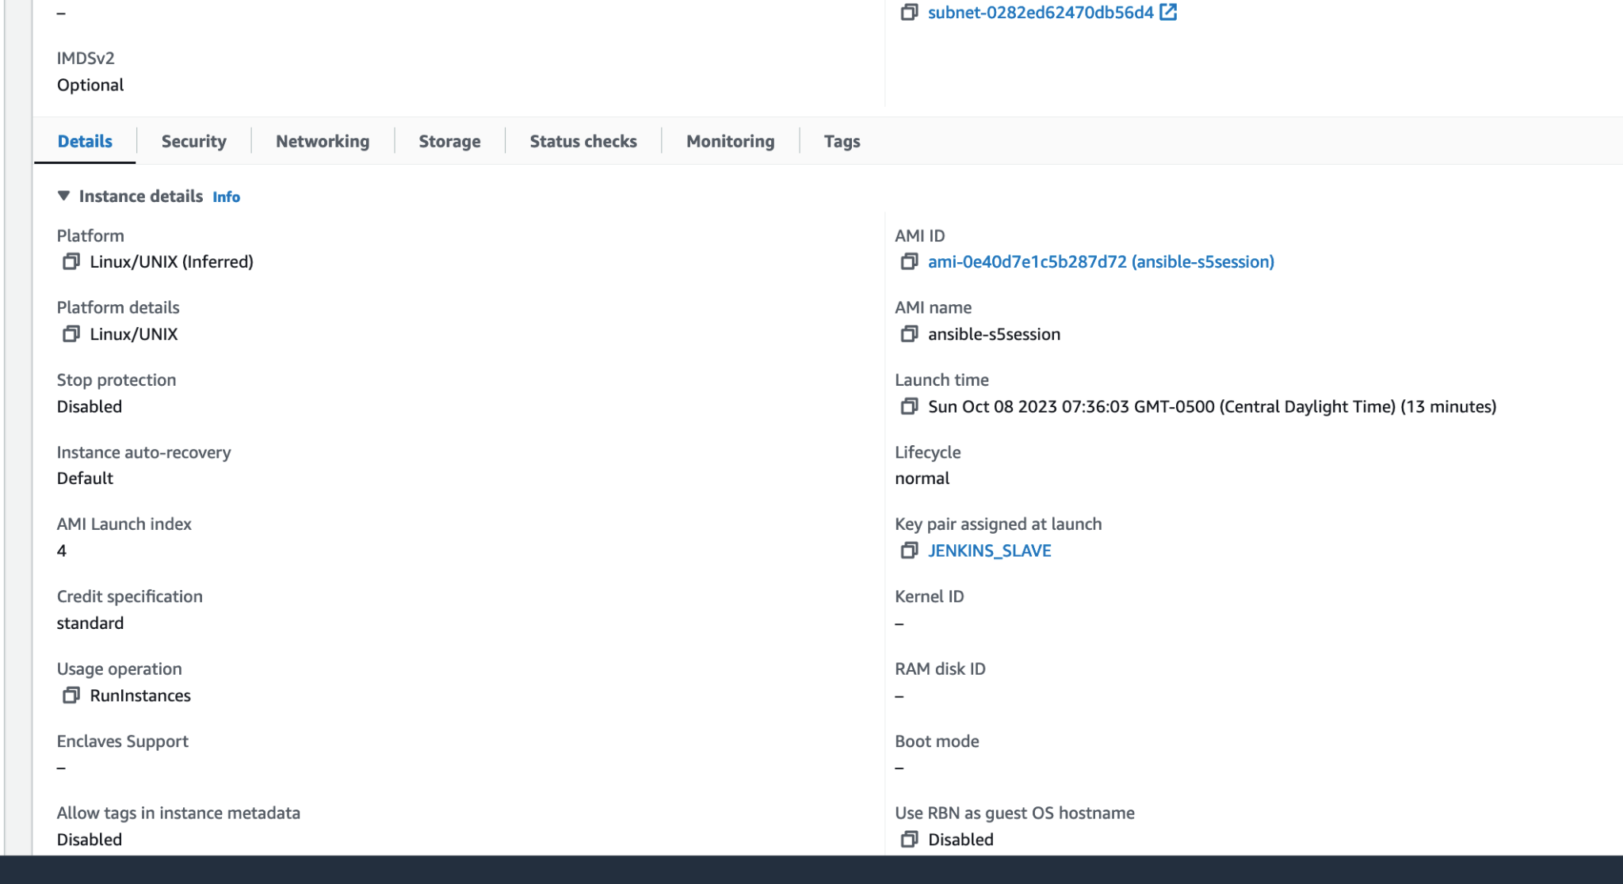
How to create a master AMI for ansible
Click here
11

Slide 68
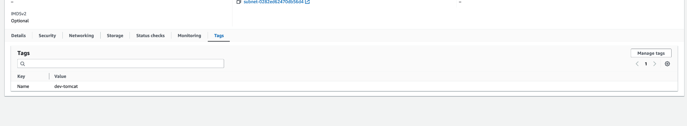
How to create a master AMI for ansible
Click here
12

Slide 69
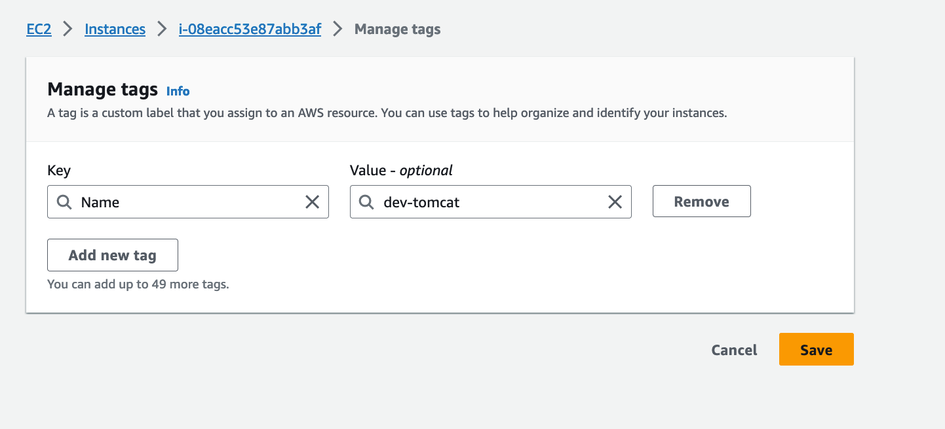
How to create a master AMI for ansible
13
Click here

Slide 70
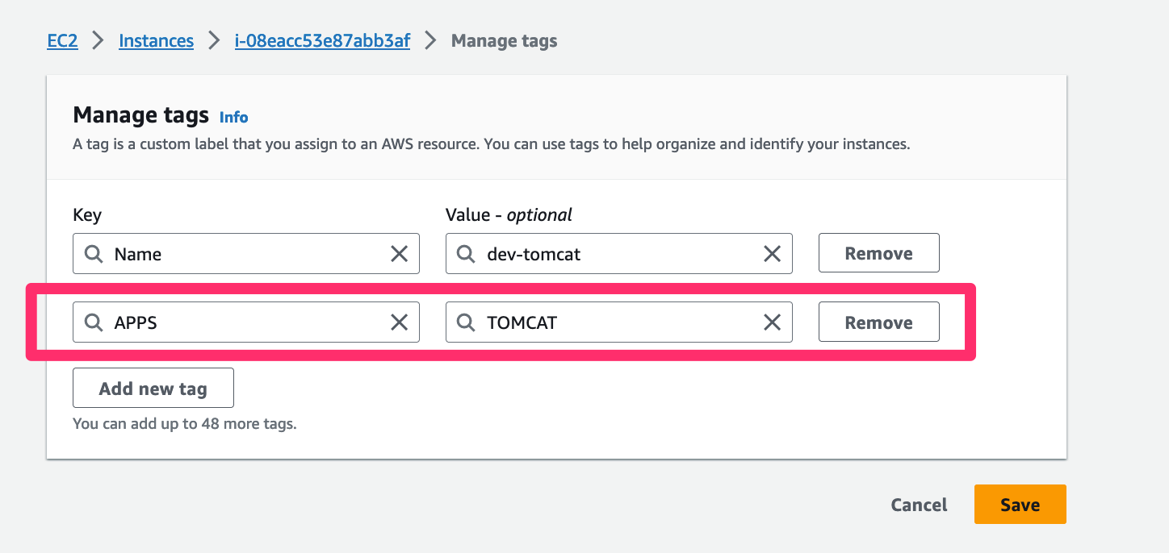
How to create a master AMI for ansible
14
Enter the required info please make sure you enter tag base on info as indicated above
15

Slide 71
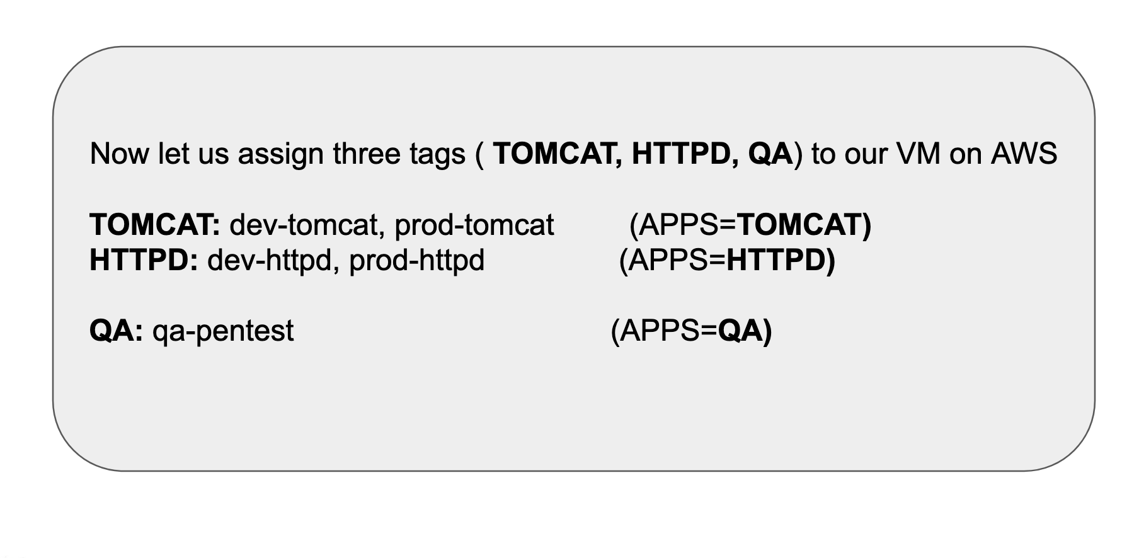
How to create a master AMI for ansible
Repeat same process for each target machine make to respect the tags

Slide 72
How to create a master AMI for ansible
CREATE A IAM ROLE WITH AmazonEC2FullAccess AND ATTACH TO YOUR ANSIBLE MASTER

Slide 73
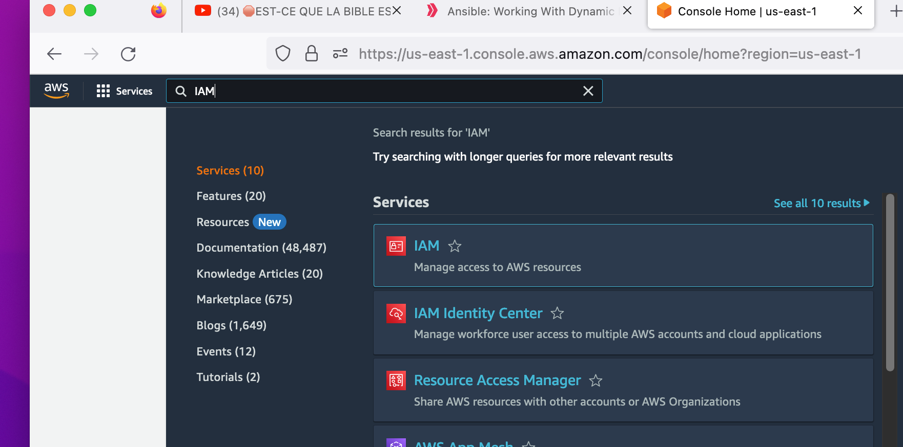
How to create a master AMI for ansible
16
Enter IAM
17

Slide 74
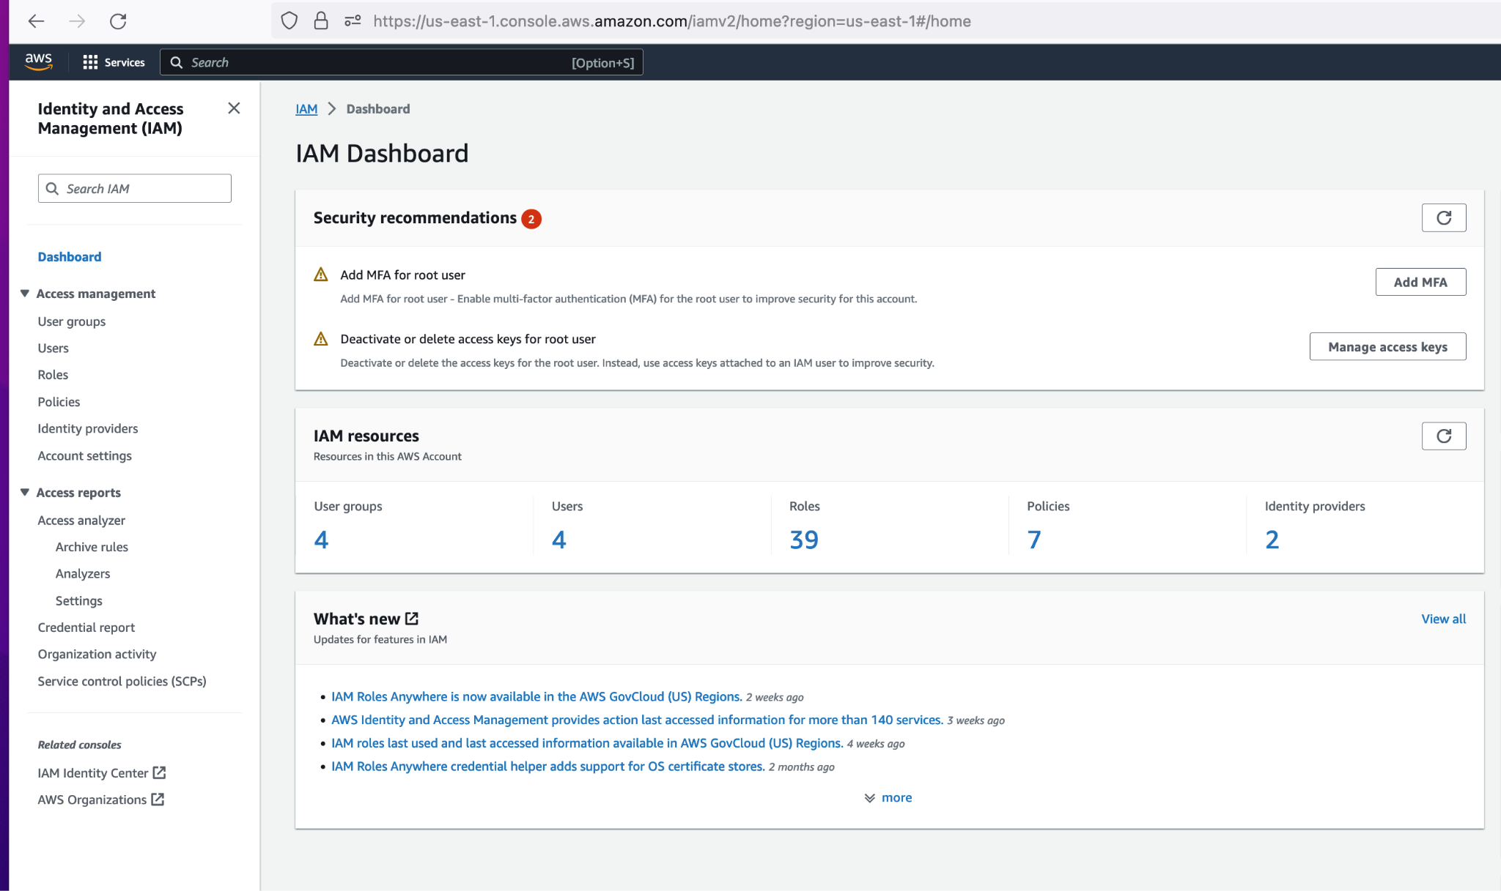
How to create a master AMI for ansible
18

Slide 75
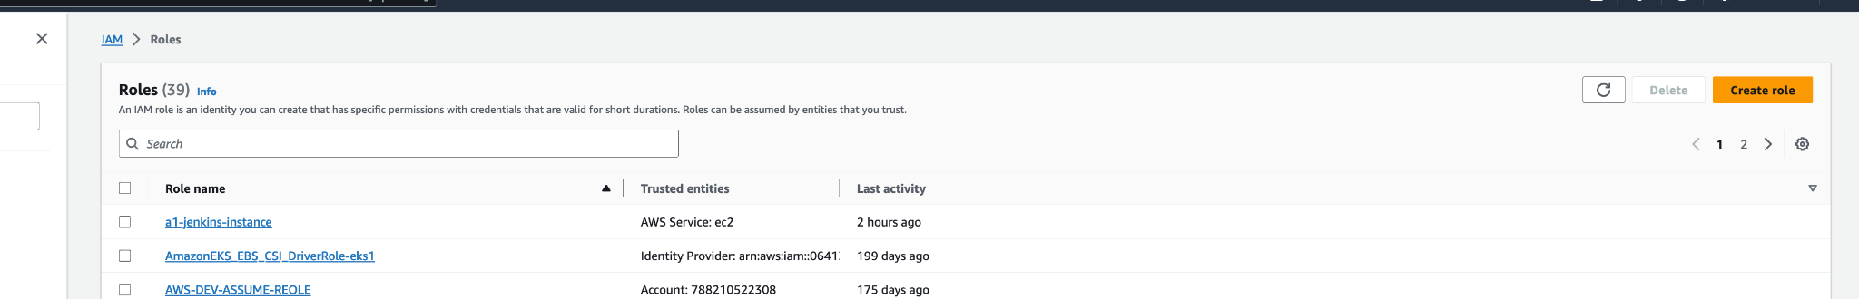
How to create a master AMI for ansible
19

Slide 76
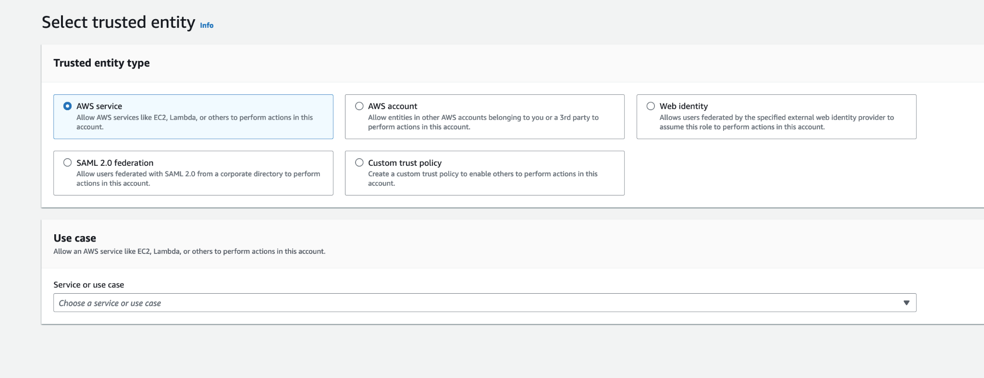
How to create a master AMI for ansible
20
21

Slide 77
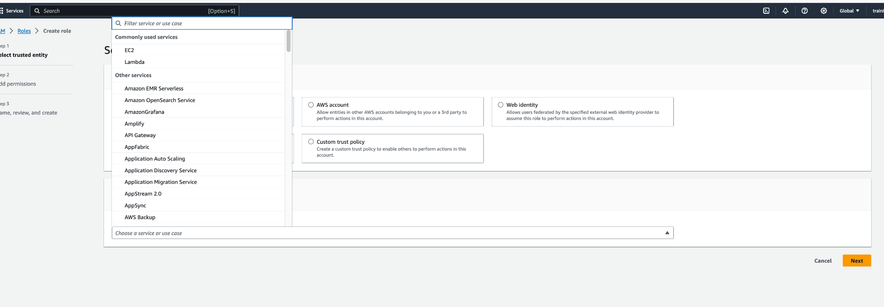
How to create a master AMI for ansible
22
23

Slide 78
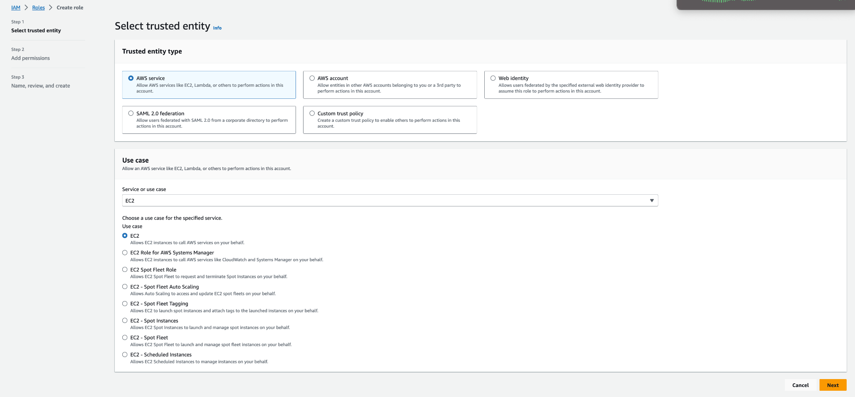
How to create a master AMI for ansible
24
25

Slide 79
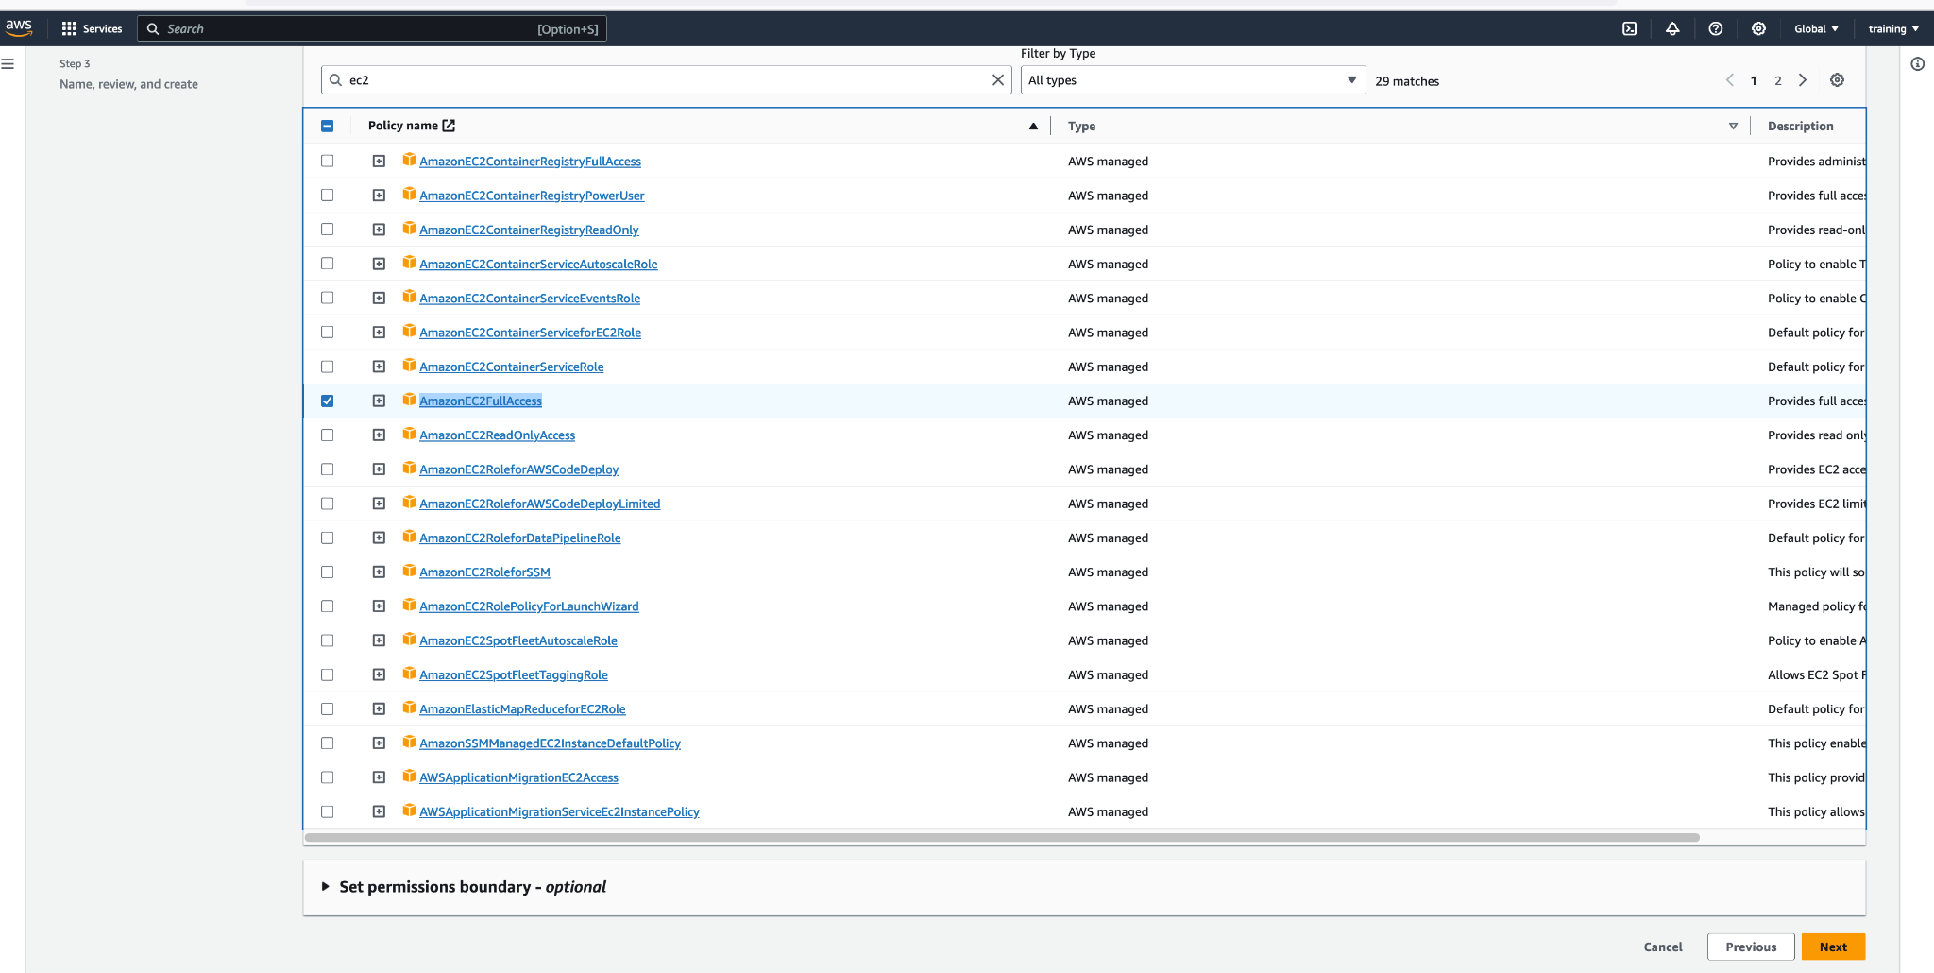
How to create a master AMI for ansible
26
27

Slide 80
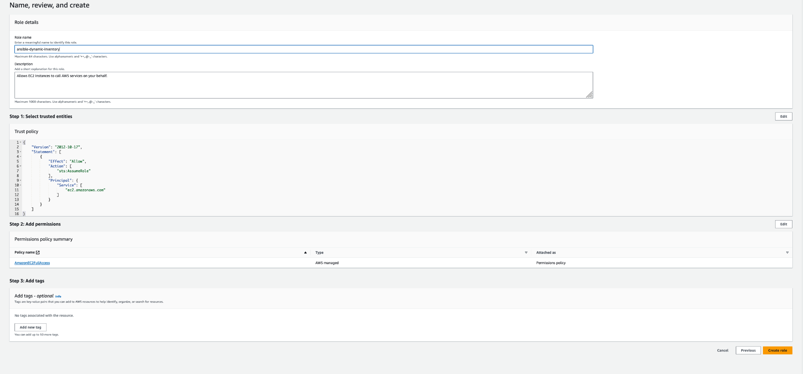
How to create a master AMI for ansible
26
27

Slide 81
How to create a master AMI for ansible
28
30
Select EC2
Click on service
29
Enter EC2

Slide 82
How to create a master AMI for ansible
Click here
32
Click here
31

Slide 83

How to create a master AMI for ansible
Click here on the ansible master
32

Slide 84

How to create a master AMI for ansible
33
35
34

Slide 85

How to create a master AMI for ansible
37
MAKE SURE TO SELECT THE ROLE YOU JUST CREATE
36
38

Slide 86
LOGIN TO THE ANSIBLE-MASTER
VM
Make sure to use ubuntu as user when you want to login
Then switch user to ansible

Slide 87
LOGIN TO THE ANSIBLE-MASTER
VM
Make sure to use ubuntu as user when you want to login
Then switch user to ansible

Slide 88
ansible.sh file
#! /bin/bash
#### update
sudo apt update -y
#### install python
sudo apt install -y python3 python3-pip
# install ansible
curl https://bootstrap.pypa.io/get-pip.py -o get-pip.py
python3 get-pip.py --user
python3 -m pip install --user ansible
python3 -m pip install --user ansible-core
export PATH="$PATH:/home/ansible/.local/bin"
echo 'export PATH="$PATH:/home/ansible/.local/bin"' >> /home/ansible/.bashrc
source /home/ansible/.bashrc
# install boto3
pip3 install --user boto3
pip install boto3 botocore
/usr/bin/python3 -m pip install boto3 botocore

Slide 89
Create a script using the content on previous slide then run the script

Slide 90
Aws_ec2.yml file
plugin: aws_ec2
regions:
- us-east-1
keyed_groups:
- prefix: ""
key: tags.Name
- prefix: ""
key: tags.APPS
filters:
instance-state-name: running
compose:
ansible_host: public_ip_address

Slide 91
let's break down the configuration provided, which is for the aws_ec2 Ansible inventory plugin:
plugin: aws_ec2:
Specifies which inventory plugin Ansible should use. In this case, it's the aws_ec2 plugin which fetches inventory from Amazon EC2.
regions::
A list of AWS regions you want to fetch instances from.
- us-east-1:
The specific AWS region you're targeting is us-east-1, which is the US East (N. Virginia) region.
keyed_groups::
A list of groups that will be created based on instance attributes. It helps in creating a structured inventory based on given attributes or tags.
- prefix: "":
This defines the prefix for the group name. An empty string ("") means no prefix will be added to the group name.
key: tags.Name:
This means the group names will be created based on the Name tag of the EC2 instances. For instance, if you have an instance with the Name tag set to "webserver", a group named "webserver" will be created with that instance in it.
- prefix: "":
Again, this defines the prefix for the group name. The empty string means no prefix will be added.
key: tags.APPS:
This configuration will create groups based on the APPS tag of the EC2 instances. So, if an instance has an APPS tag set to "database", a group named "database" will be created containing that instance.
filters::
Allows you to specify which instances should be included based on certain criteria.
instance-state-name: running:
This filter ensures only the EC2 instances in the "running" state are fetched and included in the inventory. Stopped or terminated instances will be ignored.
compose::
Lets you create complex variables based on the attributes of the fetched EC2 instances.
ansible_host: public_ip_address:
Here, it sets the ansible_host variable (which determines where Ansible will connect) to the public IP address of the fetched EC2 instances. This ensures that when you run an Ansible playbook or command against this inventory, Ansible will connect to the EC2 instances using their public IP addresses.
In summary, this configuration tells Ansible to fetch all running EC2 instances from the us-east-1 region, group them by their Name and APPS tags, and connect to them using their public IP addresses.

Slide 92

Paste the content of aws_ec2.yml file save and quit

Slide 93
Ansible.cfg file
[defaults]
inventory = /home/ansible/dynamic-inventory/inventory/aws_ec2.yml
private_key_file = /home/ansible/.ssh/id_rsa
host_key_checking = False

Slide 94
This configuration is from an ansible.cfg file, which is used to set configurations for Ansible. Let's go through it line by line:
[defaults]:
This section header specifies that the settings below are for the default Ansible configurations. The [defaults] section is where most of the general Ansible configurations are set.
inventory = /home/ansible/dynamic-inventory/inventory/aws_ec2.yml:
inventory: This defines where Ansible looks for the list of hosts to operate on.
/home/ansible/dynamic-inventory/inventory/aws_ec2.yml: This path points to a dynamic inventory configuration (based on our previous discussion, it's set up for AWS EC2). Instead of a static list of hosts, Ansible will use the AWS EC2 plugin to dynamically retrieve a list of EC2 instances based on the configurations in this file.
private_key_file = /home/ansible/.ssh/id_rsa:
private_key_file: This specifies the default private key for Ansible to use when connecting to target hosts via SSH.
/home/ansible/.ssh/id_rsa: This is the path to the private SSH key. If your EC2 instances (or other hosts) are set up to authenticate using this key, Ansible will use it for SSH connections. It's the default private key location when you run ssh-keygen without arguments.
host_key_checking = False:
host_key_checking: This setting determines if Ansible checks the remote host's SSH key fingerprint (the so-called "host key") when connecting.
False: By setting it to False, Ansible won't validate the authenticity of the host key. In typical SSH sessions, the first time you connect to a remote server, you're prompted to verify the authenticity of the host key. Disabling host key checking is common in dynamic environments (like cloud instances) where the host key might change frequently (e.g., recreating instances). However, turning this off can expose you to man-in-the-middle attacks, so use this setting with understanding and caution.
In essence, this configuration sets up Ansible to use a dynamic AWS EC2 inventory, connects to hosts using a specific private key, and disables SSH host key checking.

Slide 95

Really did you just say that Eric this is not working
Come on
These servers have been terminated already in AWS
Please just follow the example with your own set of servers

Slide 96



Slide 97
The text provided looks like the output of the ansible-inventory --list command when it's displaying the inventory in a tree-like structure. This output shows groups of hosts and their members, reflecting how Ansible categorizes machines in its inventory.
Let's break it down:
@all::
Represents all hosts managed by Ansible. Every host will be part of this group.
|--@ungrouped::
Represents hosts that are not part of any defined group in the inventory.
|--@aws_ec2::
This is a group named aws_ec2. The hosts listed under this group appear to be AWS EC2 instances. The hostnames indicate that they are in the compute-1.amazonaws.com domain, which corresponds to the us-east-1 AWS region.
|--@_prod_tomcat::
This is a group named _prod_tomcat, possibly representing production servers running the Tomcat application server. The EC2 instance listed under this group is part of this group.
|--@_TOMCAT::
Another group related to Tomcat, but it seems to be more general than the _prod_tomcat group, as it has more instances.
|--@_prod_httpd: and |--@_HTTPD::
These are groups presumably related to servers running the httpd service (commonly Apache). The _prod_httpd seems to denote production servers running httpd, whereas _HTTPD could be a more general group.
|--@_ansible_master::
A group likely representing the master node(s) for Ansible operations.
|--@_dev_httpd: and |--@_dev_tomcat::
Groups indicating development servers running httpd and Tomcat, respectively.
|--@_qa_pentest: and |--@_QA::
QA-related groups, with _qa_pentest possibly being a group for penetration testing in a QA environment.
Each group contains a list of hostnames (EC2 instances in this case) that are members of that group. When you run an Ansible playbook against a specific group, only the hosts within that group are targeted.
Overall, this tree-structured output gives you a clear view of the organization of hosts in your Ansible inventory, making it easier to understand and manage the infrastructure.

Slide 98

Really did you just say that Eric this is not working
Come on
These servers have been terminated already in AWS
Please just follow the example with your own set of servers

Slide 99

Really did you just say that Eric this is not working
Come on
These servers have been terminated already in AWS
Please just follow the example with your own set of servers

Slide 100


